Slide 1
Web Science:
Archiving the Web
(Part 1 - Why Archive the Web?)
CS 432/532
Old Dominion University
Permission has been granted to use these slides from Frank McCown, Michael L. Nelson, Alexander Nwala, Michele C. Weigle
This work is licensed under a Creative Commons Attribution-NonCommercial-ShareAlike 3.0 Unported License

Slide 2
Web Archiving
Web archiving is the process of collecting pages from the Web and saving them in an archive
Usually it's important to save all associated resources (images, style sheets, etc.) to preserve look
Archives are typically produced using web crawlers

Slide 3
Why archive the Web?
If the Web isn't saved, we might lose a significant amount of our digital heritage
The Web gives historians and other social scientists significant insight into our society, especially into how technology has affected it
Serves as important resource in many lawsuits
Some organizations want to or are legally obligated to archive their web materials
Someone worked hard on this stuff, why not save it?
See also WS-DL's celebration of IA's 20 year anniversary, Nov 2016

Slide 4
Why Care About The Past?
From an anonymous WWW 2010 reviewer about our
Memento paper (emphasis mine):
"Is [sic] there any statistics to show that many or a good number of Web users would like to get obsolete data or resources? "
one answer: replay of contemporary pages >> summary pages
Ref: Nelson and Weigle, "Why Care About the Past?" (slides)

Slide 5
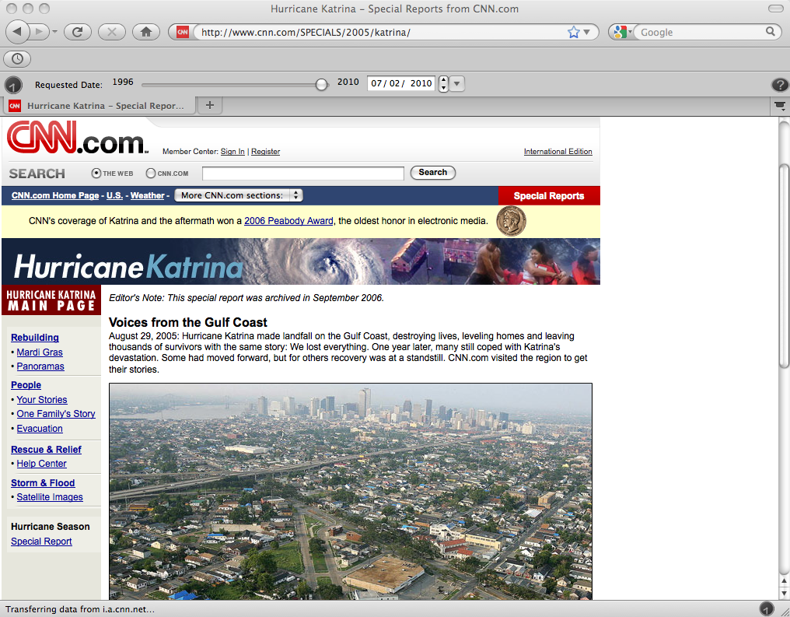
Notes:
http://www.cnn.com/SPECIALS/2005/katrina/

Slide 6
vs.

Slide 7
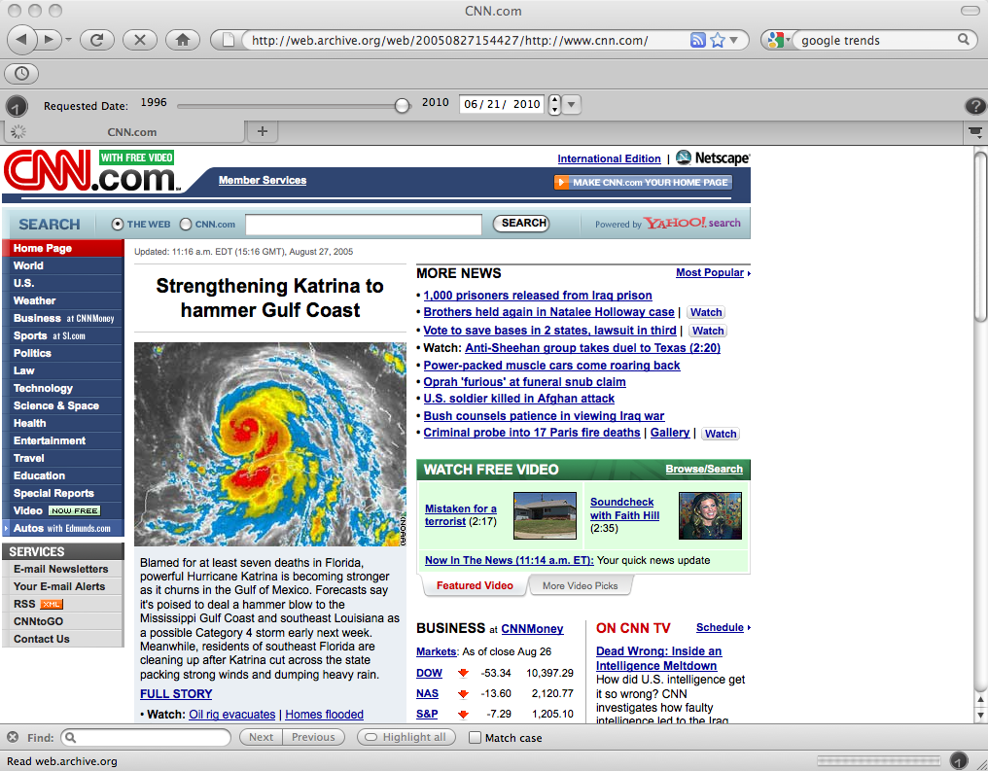
August 27, 2005
11:16 am EDT
Notes:
https://web.archive.org/web/20050827154427/http://www.cnn.com/

Slide 8
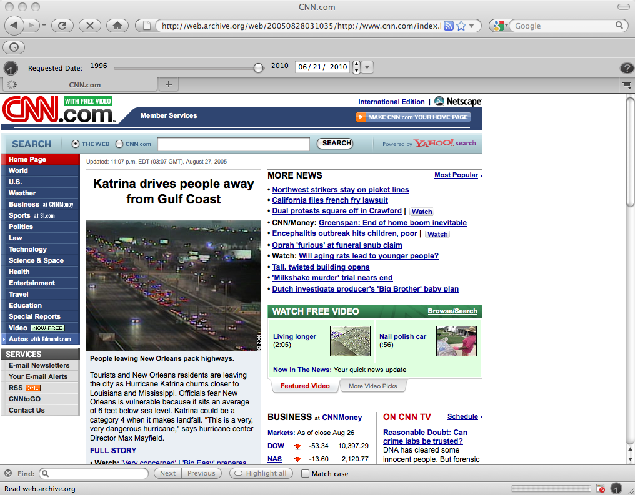
August 27, 2005
11:07 pm EDT
Notes:
https://web.archive.org/web/20050828031035/http://www.cnn.com/index.html

Slide 9
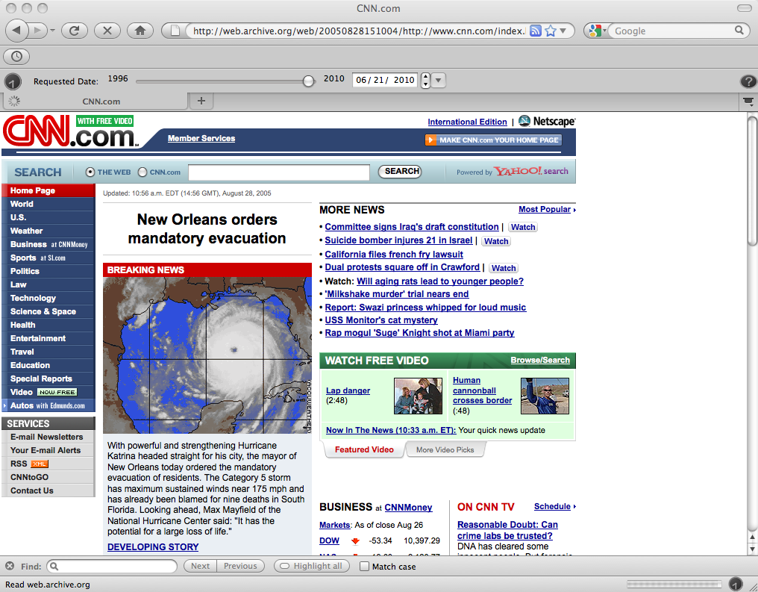
August 28, 2005
11:34 am EDT
Archived NWS message, Aug 28, 2005, 10am CDT
Notes:
https://web.archive.org/web/20050828155226/http://www.cnn.com:80/

Slide 10
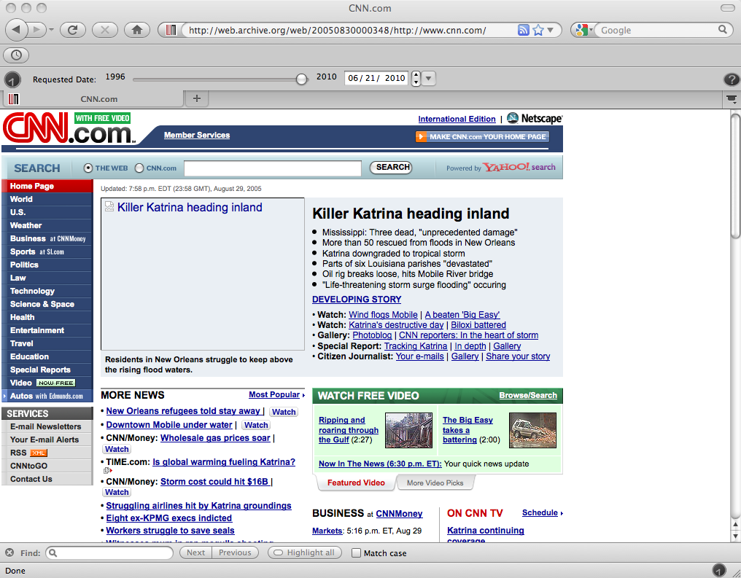
August 28, 2005
11:34 am EDT
Notes:
https://web.archive.org/web/20050830000348/http://www.cnn.com/

Slide 11
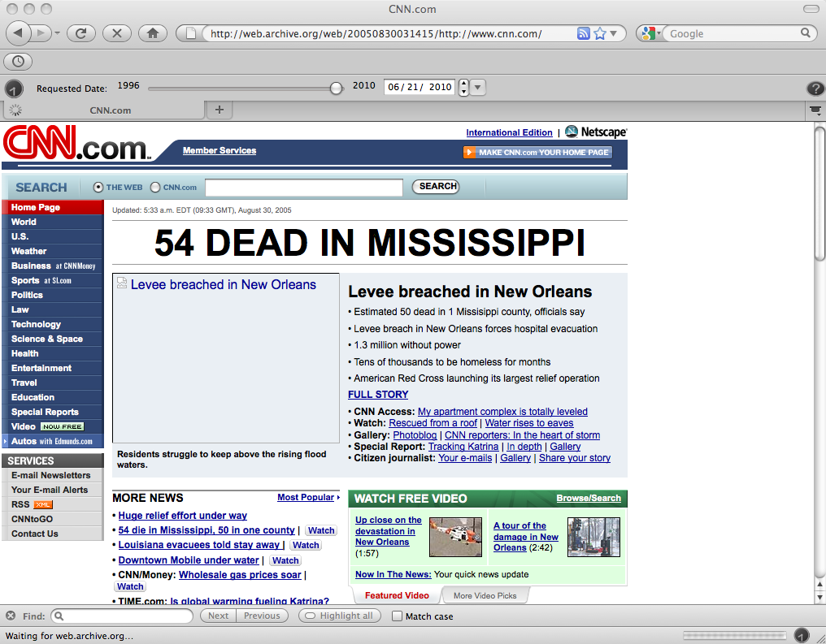
August 30, 2005
5:33 am EDT
Notes:
https://web.archive.org/web/20050830031415/http://www.cnn.com/

Slide 12
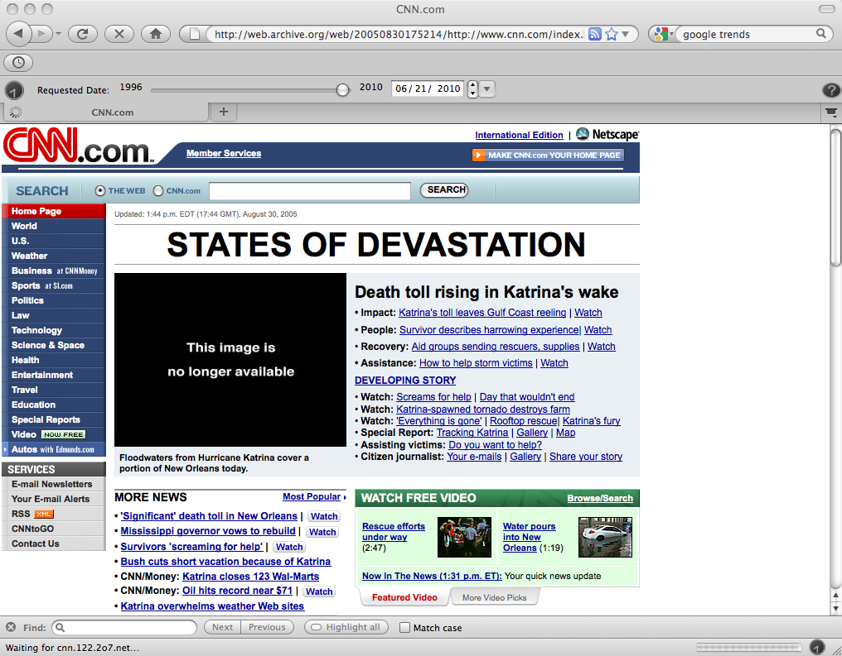
August 30, 2005
1:44 pm EDT
Notes:
https://web.archive.org/web/20050830175214/http://www.cnn.com/index.html

Slide 13
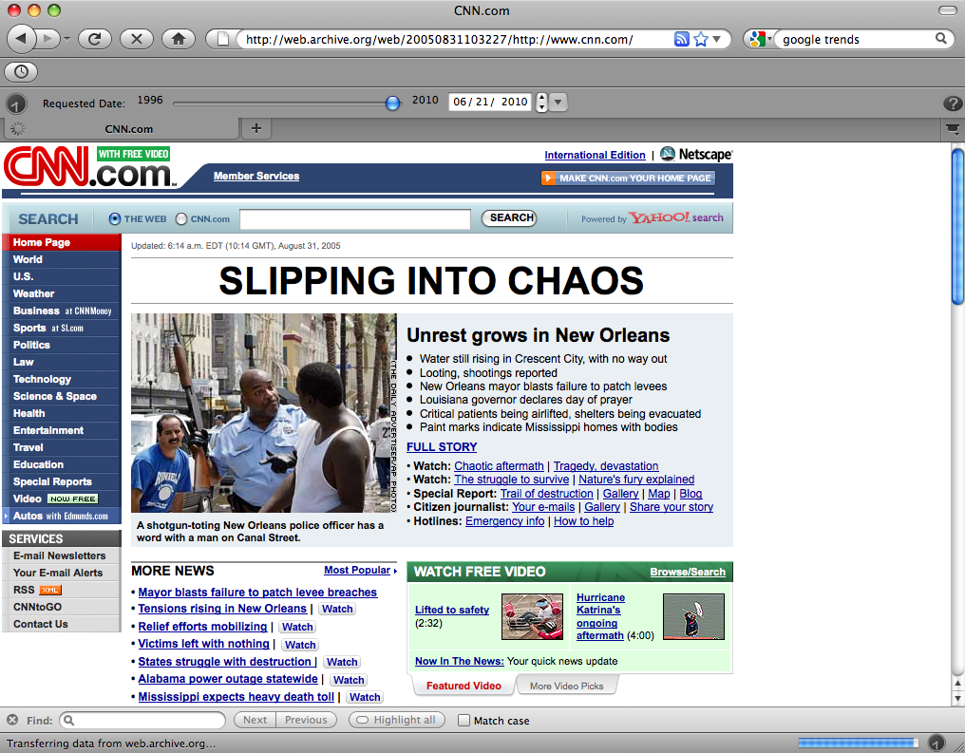
August 31, 2005
6:14 am EDT
Notes:
https://web.archive.org/web/20050831103227/http://www.cnn.com/

Slide 14
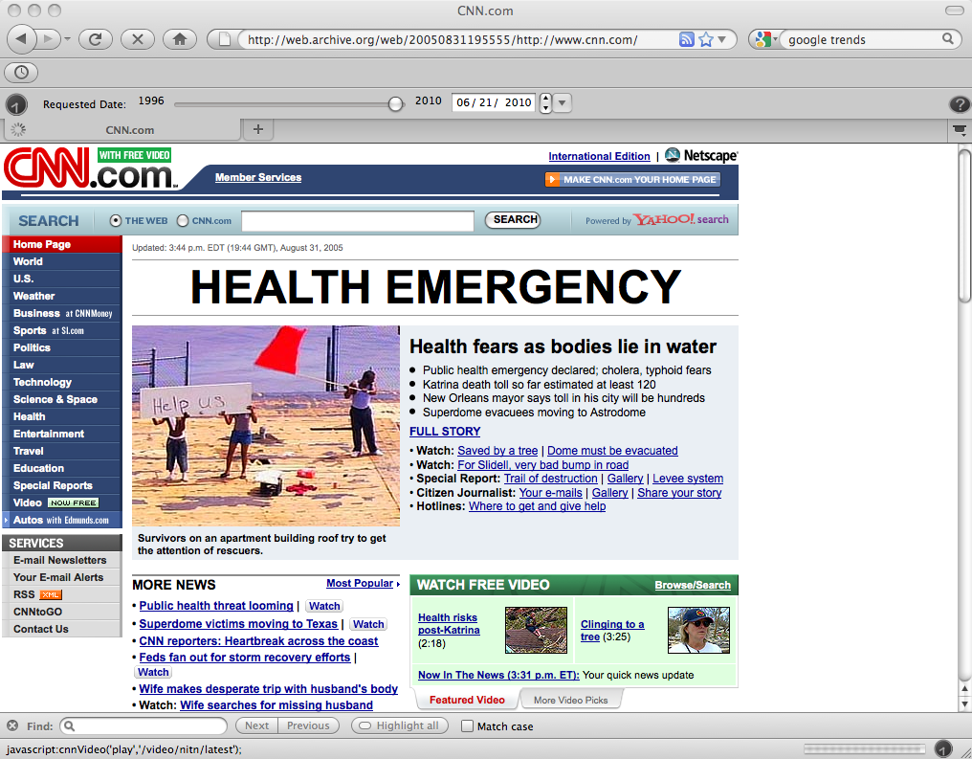
August 31, 2005
3:44 pm EDT
Notes:
https://web.archive.org/web/20050831195555/http://www.cnn.com/

Slide 15
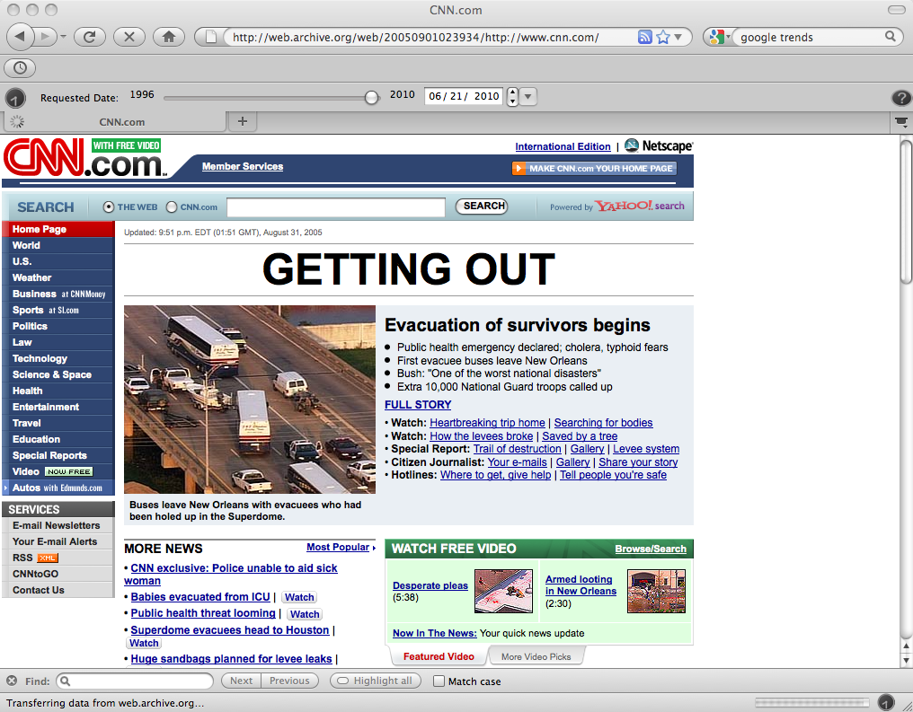
August 31, 2005
9:51 pm EDT
Notes:
https://web.archive.org/web/20050901023934/http://www.cnn.com/

Slide 16
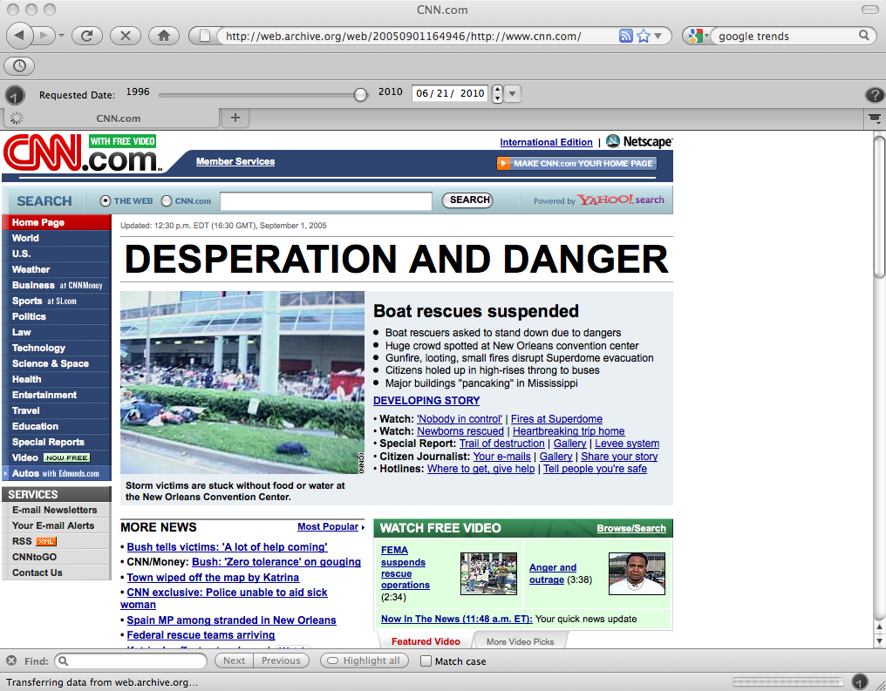
September 1, 2005
12:30 pm EDT
Notes:
https://web.archive.org/web/20050901164946/http://www.cnn.com/

Slide 17
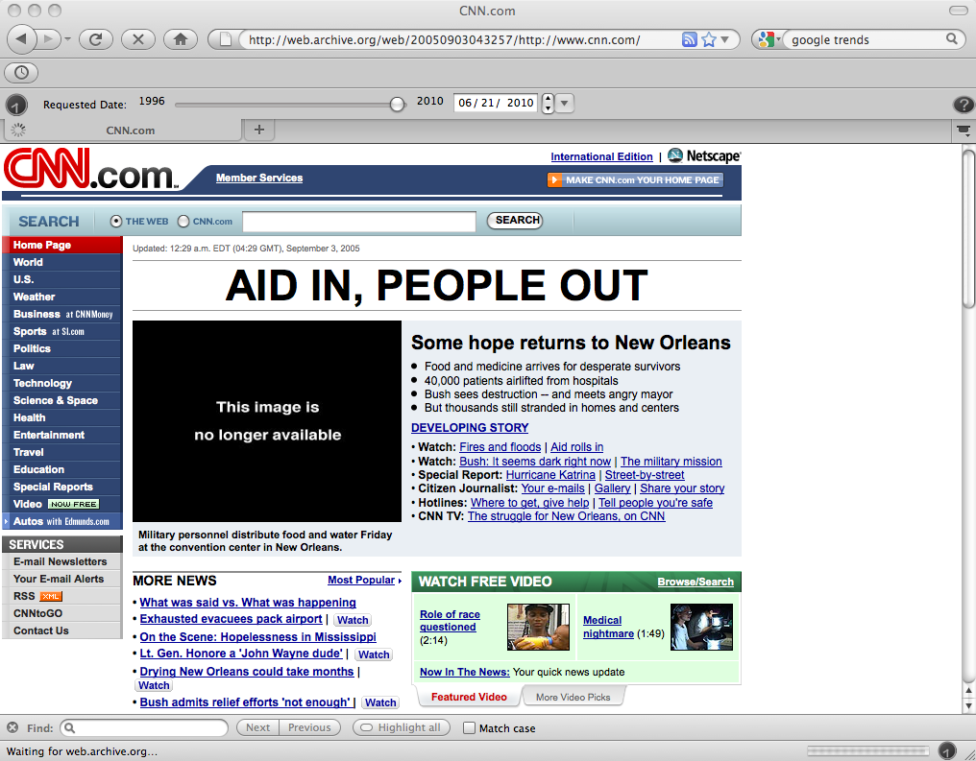
September 3, 2005
12:29 am EDT
Notes:
https://web.archive.org/web/20050903043257/http://www.cnn.com/

Slide 18
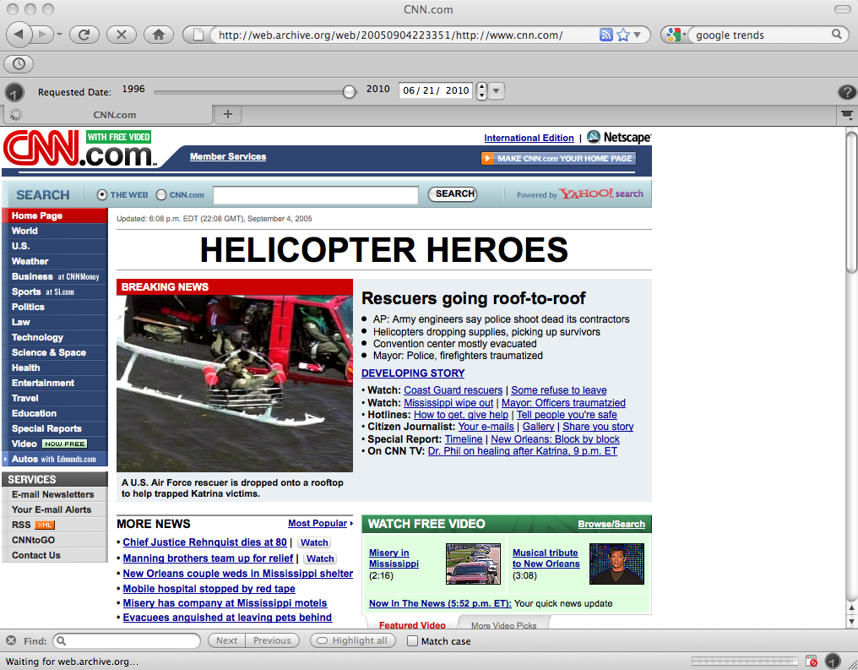
September 4, 2005
4:08 pm EDT
Notes:
https://web.archive.org/web/20050904223351/http://www.cnn.com/

Slide 19
Archiving Moves At Hurricane Speed, Most News Stories Move Faster

Slide 20
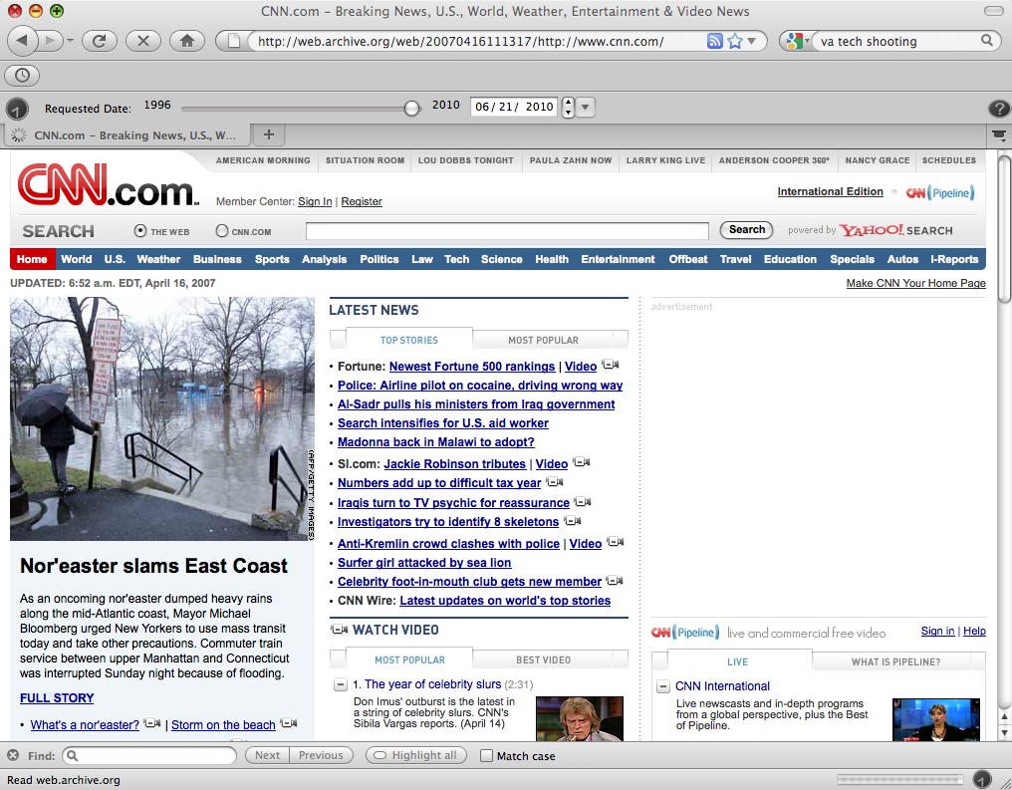

Slide 21
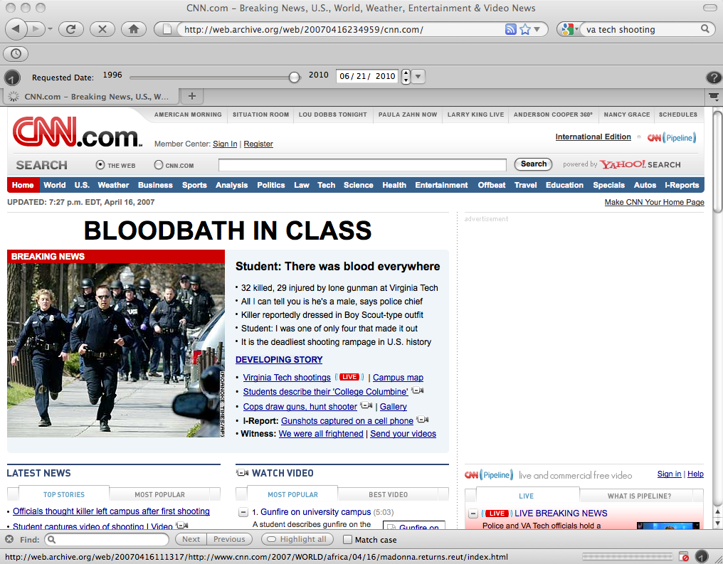

Slide 22
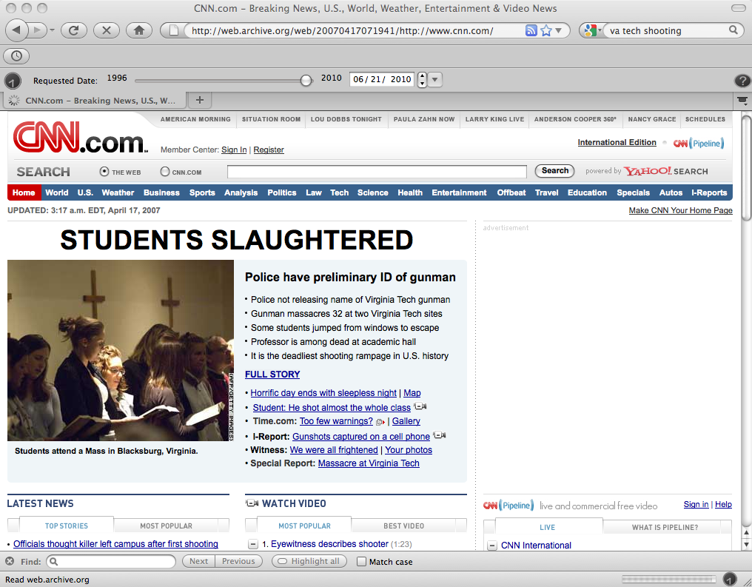

Slide 23
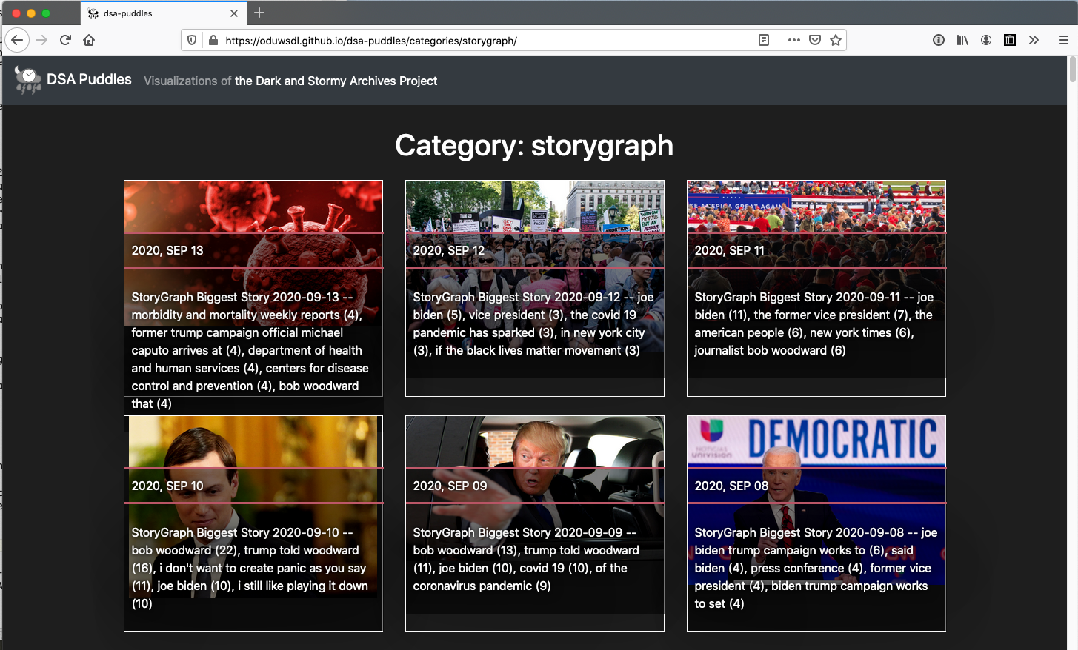
SHARI
WS-DL blog, "SHARI: StoryGraph Hypercane ArchiveNow Raintale Integration -- Combining WS-DL Tools For Current Events Storytelling"
Storygraph stories at DSA Puddles @StormyArchives on Twitter

Slide 24

StoryGraph Biggest Story 2020-04-10

Slide 25
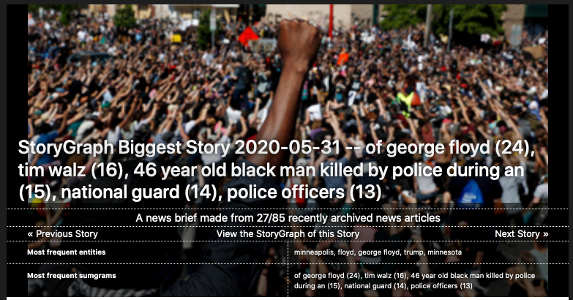
StoryGraph Biggest Story 2020-05-31

Slide 26
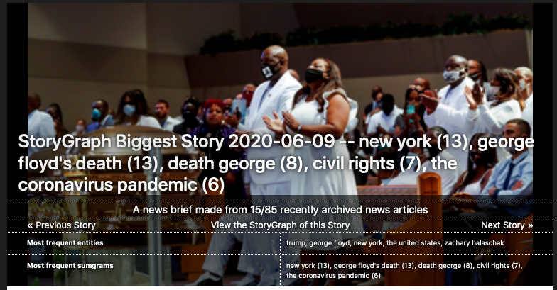
StoryGraph Biggest Story 2020-06-09

Slide 27
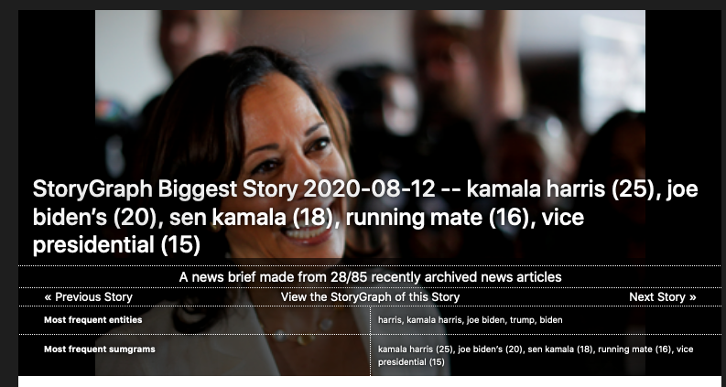
StoryGraph Biggest Story 2020-08-12

Slide 28
Web Science:
Archiving the Web
(Part 2 - How is the Web Archived and How Much of the Web Is Archived?)
CS 432/532
Old Dominion University
Most slides are courtesy Dr. Frank McCown, Dr. Michael L. Nelson, and Alexander Nwala
This work is licensed under a Creative Commons Attribution-NonCommercial-ShareAlike 3.0 Unported License

Slide 29
Who is Archiving the Web?

Slide 30
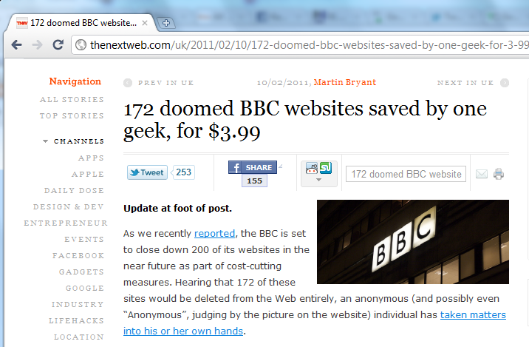
Heroic solo efforts
good? yes. complete story? no.
1TB endowment = ~$4700: Rosenthal, "Paying for Long-Term Storage", Feb 2011

Slide 31
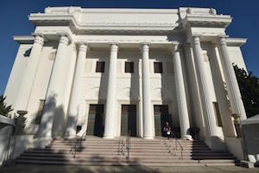

Who is archiving the Web?
Internet Archive
Founded by Brewster Kahle in 1996
Largest web archive in the world (~470B webpages)
Pages available to public via the Wayback Machine
200k software programs, 20M books, 4M videos, 4.5M audio recordings, 3M images (as of Jan 2020)
Image sources: "About IA"

Slide 32
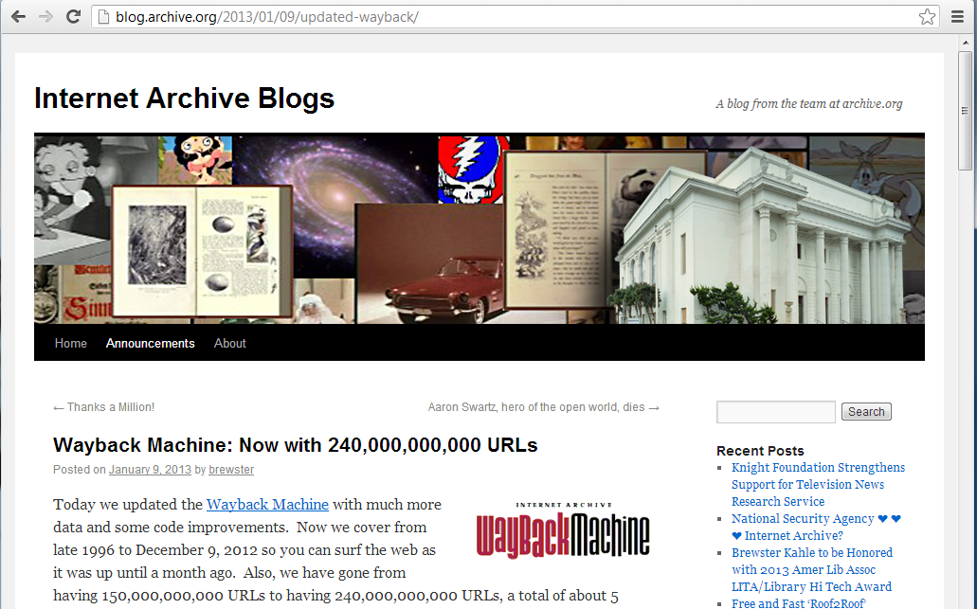
85B in 2006: Wayback Machine has 85 Billion Archived Webpages
532B URIs, 279B pages in Jan 2017: Brewster Kahle on Twitter, Jan 2018
703B URIs, Jan 2019: Brewster Kahle on Twitter, Jan 2019
881B URIs, Jan 2020: Brewster Kahle on Twitter, Jan 2020
468B pages, Sep 2020: Internet Archive on Twitter, Sep 2020

Slide 33
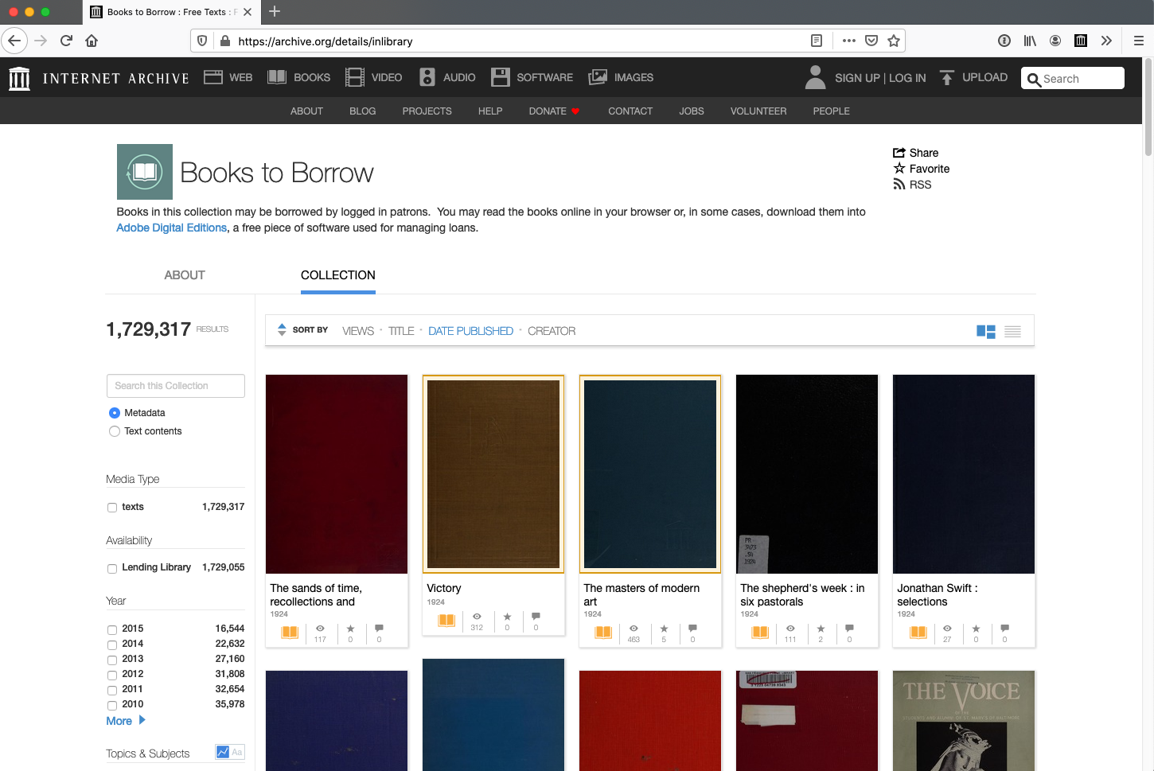
Books to Borrow

Slide 34
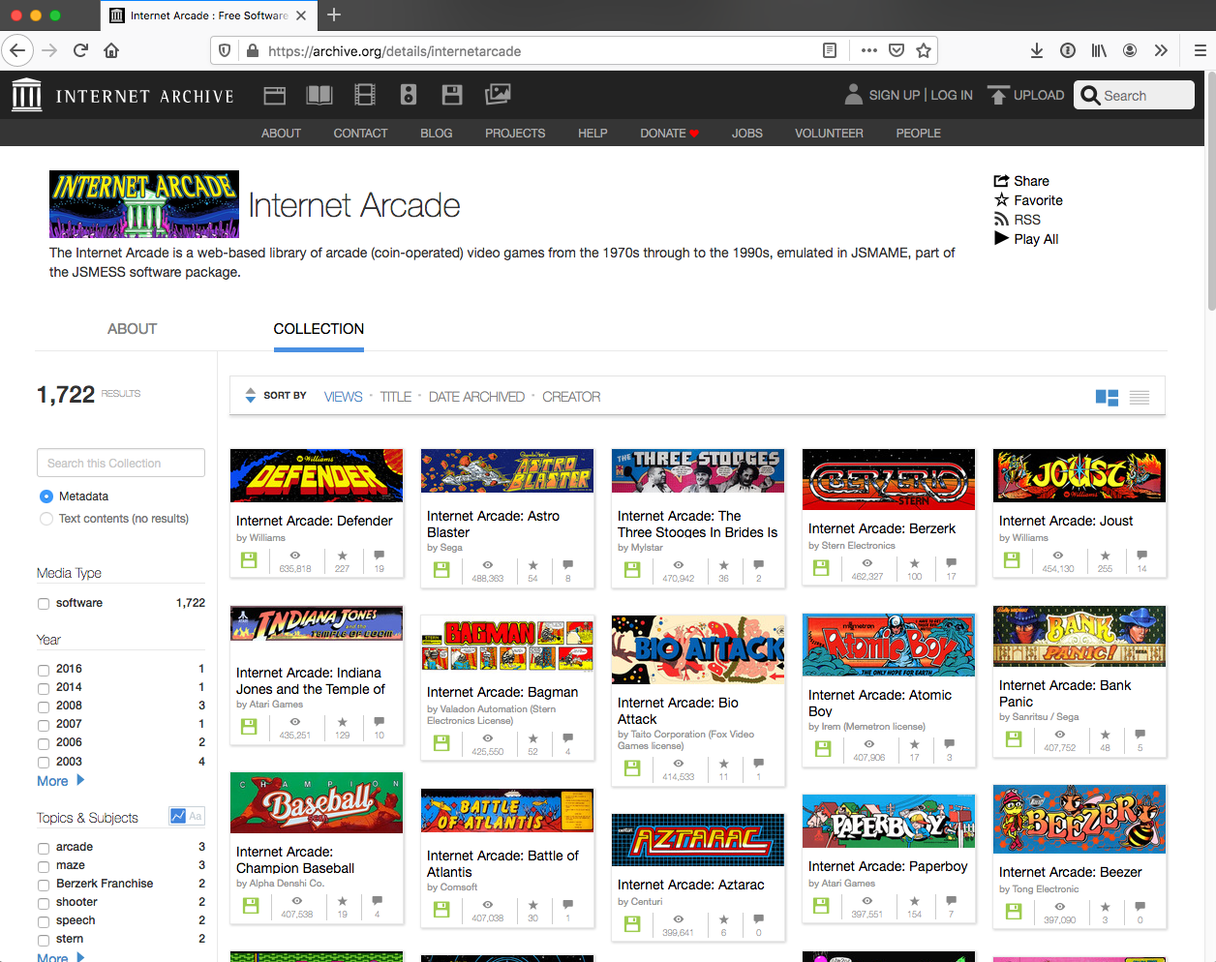
Internet Arcade

Slide 35
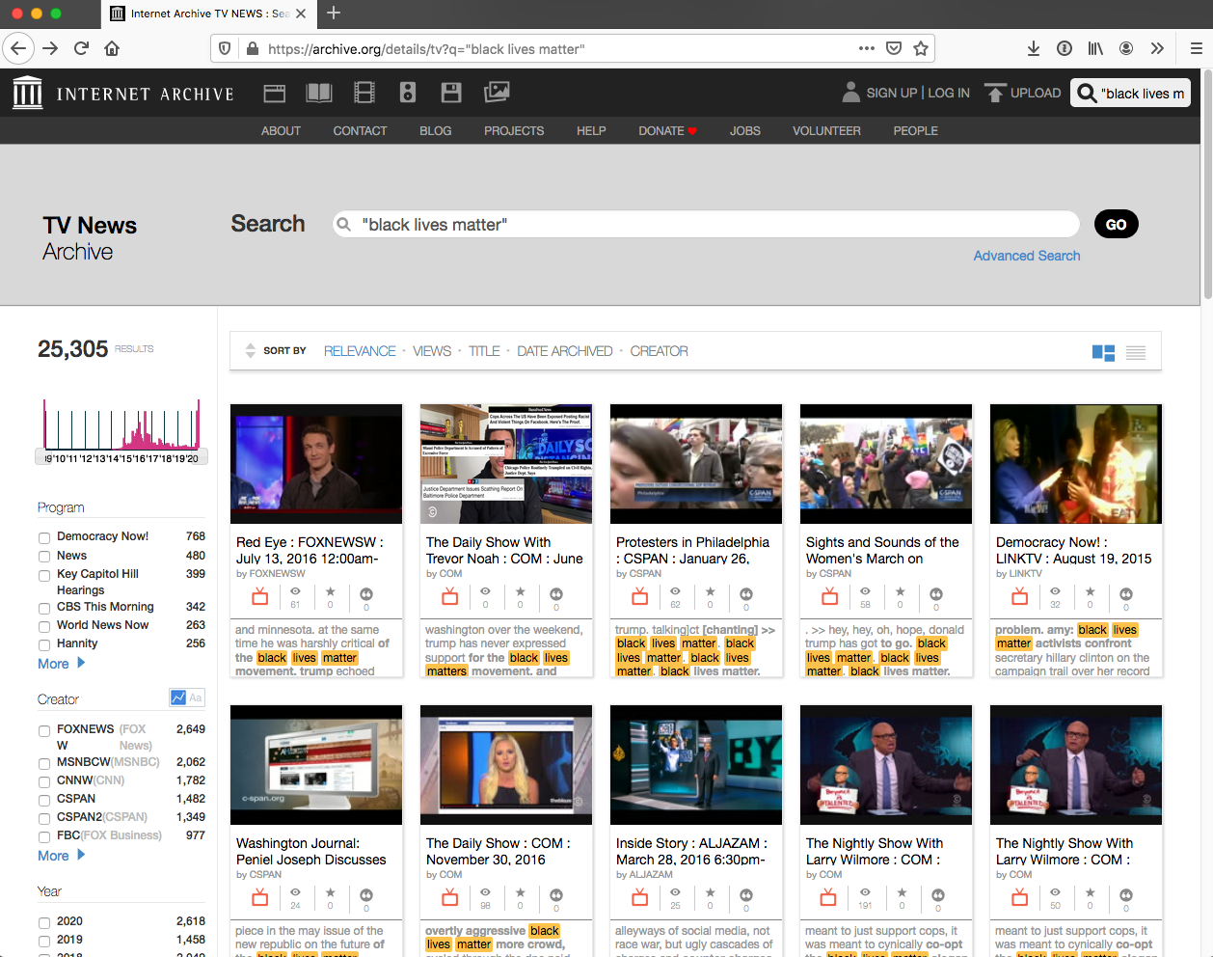
Internet Archive TV News

Slide 36
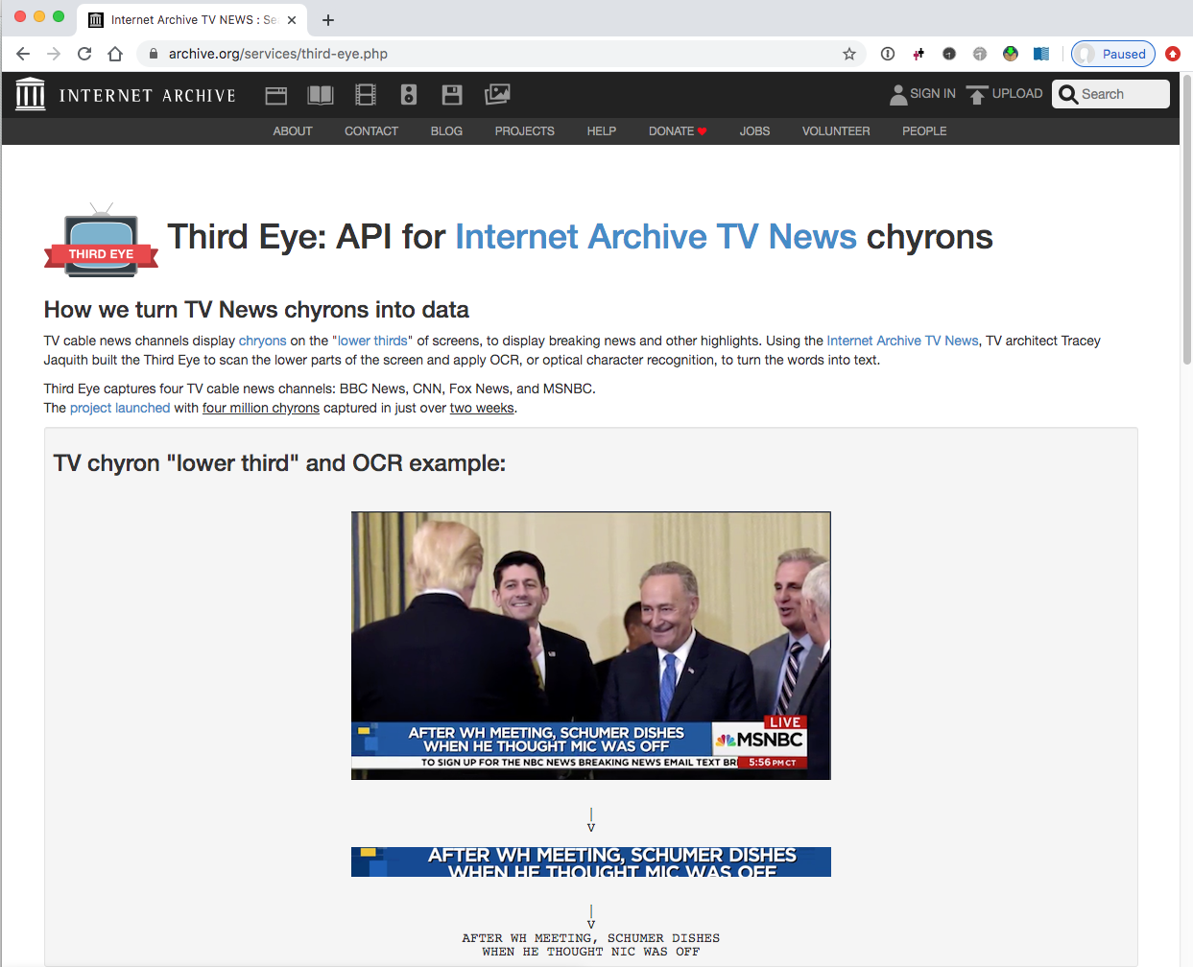
Third Eye: API for Internet Archive TV News chyrons

Slide 37
Who is archiving the Web?
National libraries & national archives, usually focusing on culturally significant web collections
list from the IIPC: Member Archives (page archived in 2017)
Commercial organizations
Hanzo Archives: commercial web archiving tools
ref: Compliance Archiving
Nextpoint: archiving service for organizations
ref: Automated Ediscovery Software / How It Works
PageFreezer: electronic records management
ref: Pagefreezer Website Archiving Solutions

Slide 38
Other Players
Free on-demand archiving (page-at-a-time model, not a crawler)
Conifer
used to be webrecorder.io
WebCite
but no longer accepting new pages
archive.is
freezePage
Perma.cc

Slide 39
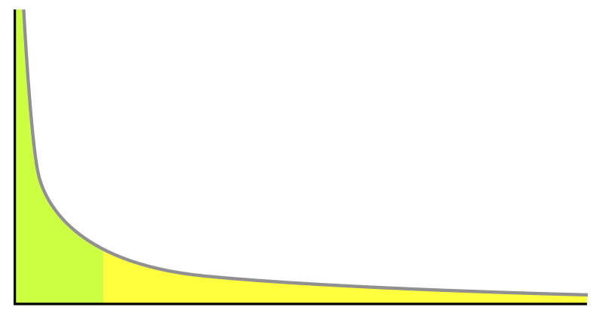






Long Tail of Archives
Archive.is

Slide 40
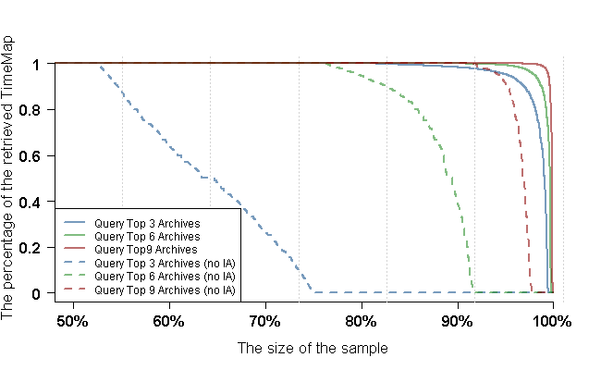
Using Only Top-k Archives for URI Lookup Yields Good Results
Even when there are 100s of archives, we only need to talk to a few.
see: Profiling Web Archive Coverage for Top-Level Domain and Content Language

Slide 41
How is the Web Archived?

Slide 42
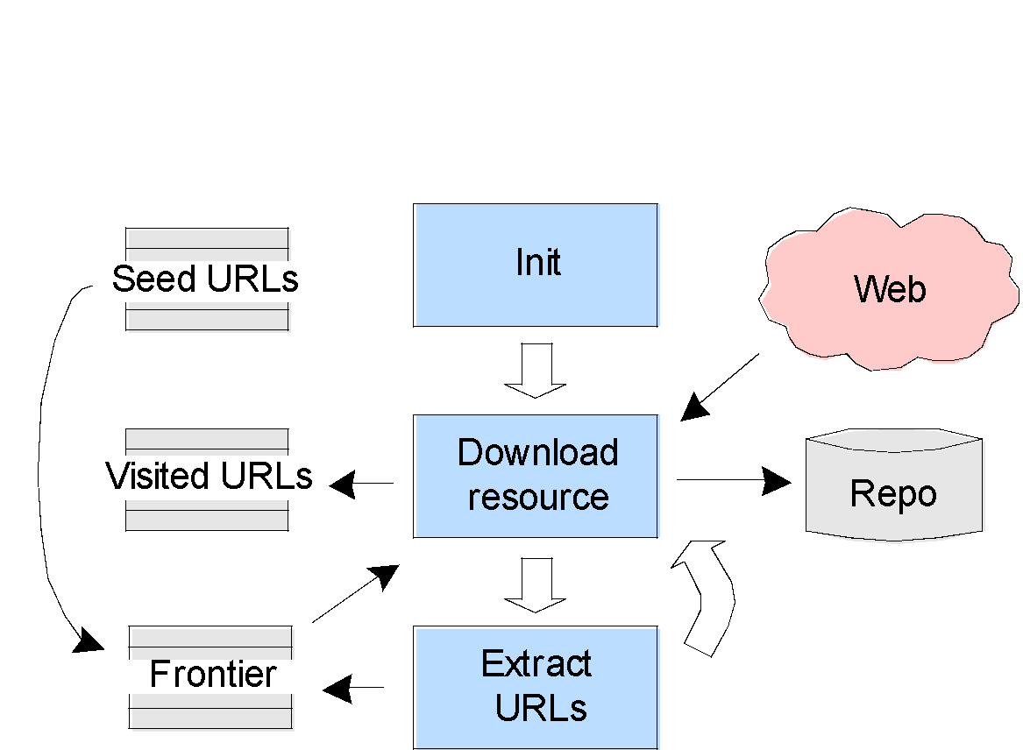
Web Crawler
Web crawlers are used to fetch a page, place all the page's links in a queue, and continue the process for each URL in the queue
Figure: McCown, Lazy Preservation: Reconstructing Websites from the Web Infrastructure, Dissertation, 2007
See also: Web crawler (Wikipedia)

Slide 43
Web Crawlers
Wget and HTTrack
Simple tools for mirroring a website
All crawled URLs are converted into a path and file
http://foo.org/test/ saved as foo.org/test/index.html
Not designed for large-scale crawling
Heritrix
Built by Internet Archive and Nordic national libraries for larger web archiving tasks
Archived content stored in Web ARChive file format (WARC)
Uses web interface
Can find links in JavaScript, Flash, etc.

Slide 44
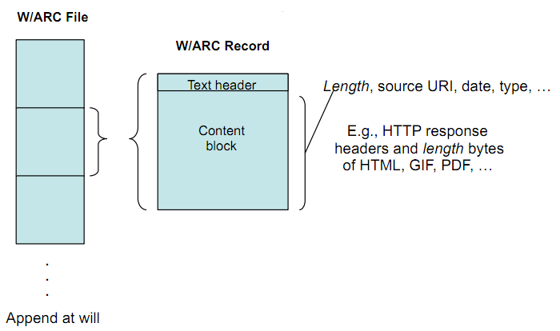
WARC File Organization
Slide from John Kunze, WARC: an archiving format for the Web

Slide 45
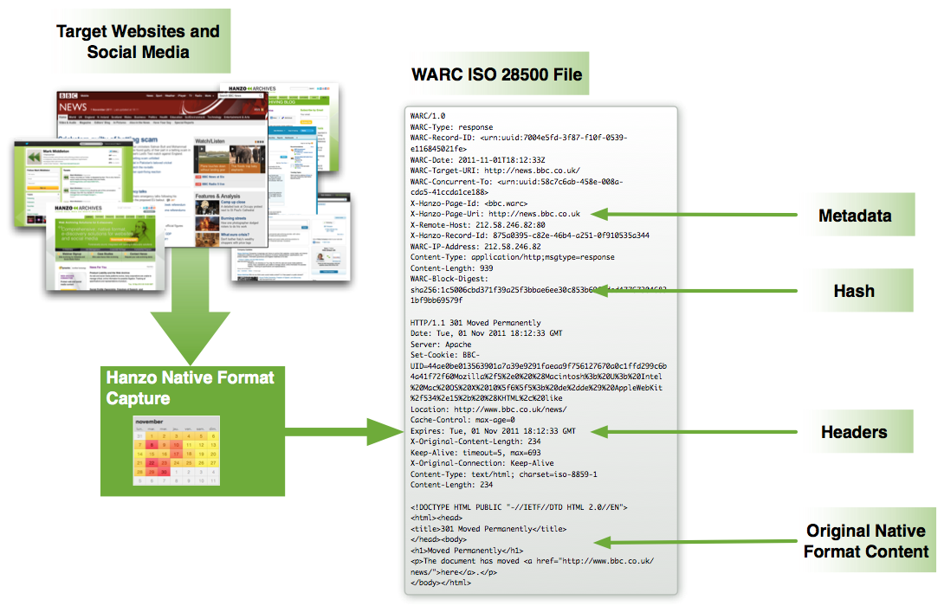
Image from Hanzo, ISO 28500 WARC FAQ

Slide 46
WARC Tools
warc-tools
Python scripts for interacting with WARC files
internetarchive/warctools: Command line tools and libraries for handling and manipulating WARC files (and HTTP contents)
WARCreate & WAIL - developed at ODU
WS-DL blog, "WARCreate and WAIL: WARC, Wayback and Heritrix Made Easy"
WS-DL blog, "Electric WAILs and Ham"
WS-DL blog, "Replacing Heritrix with Chrome in WAIL, and the release of node-warc, node-cdxj, and Squidwarc"
Webrecorder
Webrecorder Tools

Slide 47
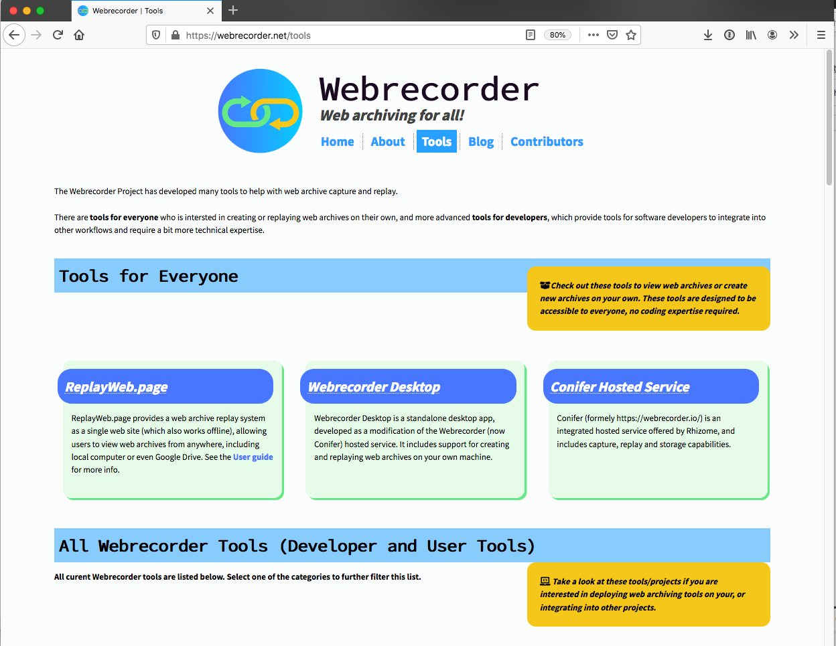
Webrecorder Tools

Slide 48
Archive Viewers/Searchers
OpenWayback
Open source Java implementation of IA's Wayback Machine
Search by URL
pywb
Python implementation of IA's Wayback Machine
NutchWAX
Full-text search of a web archive
Shine
UK WebArchive Shine
Web archive search, based on Apache SOLR

Slide 49
How Much of The Web Is Archived?

Slide 50










Public Archives, ca. Late 2010 / Early 2011
Three categories of archives
Internet Archive
Search engine
Other archives
UK
US
See also: Ainsworth et al., "How Much of the Web Is Archived?"

Slide 51
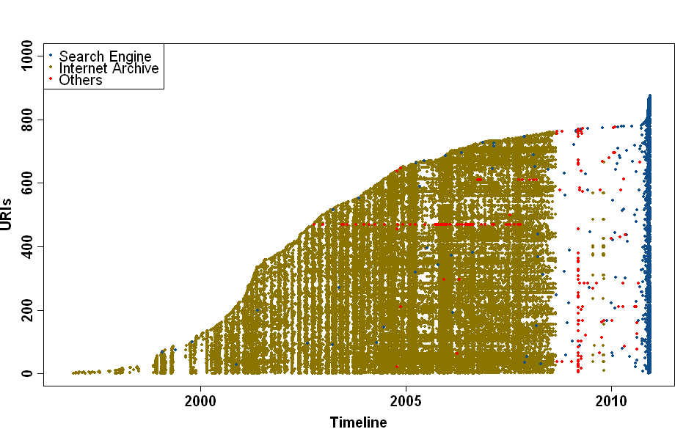
1000 URIs Ordered by First Observation Date
See also: WS-DL blog, "How Much of the Web Is Archived?"

Slide 52

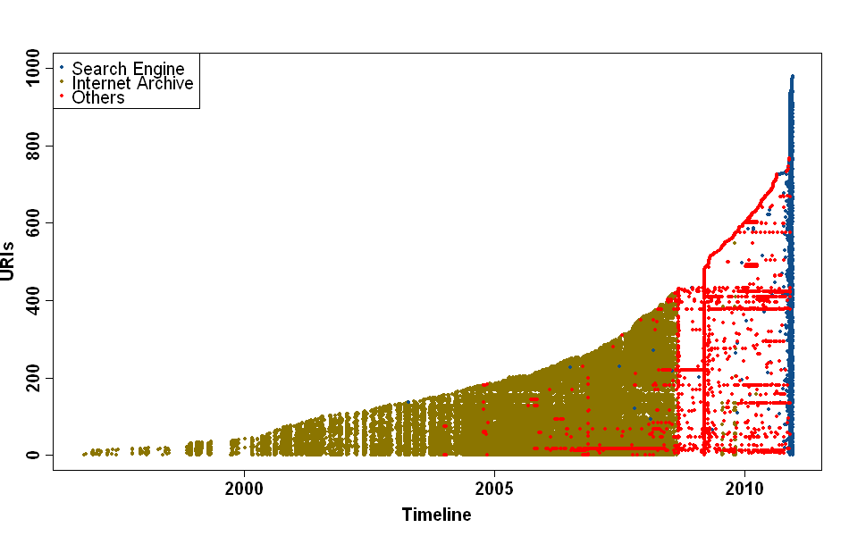


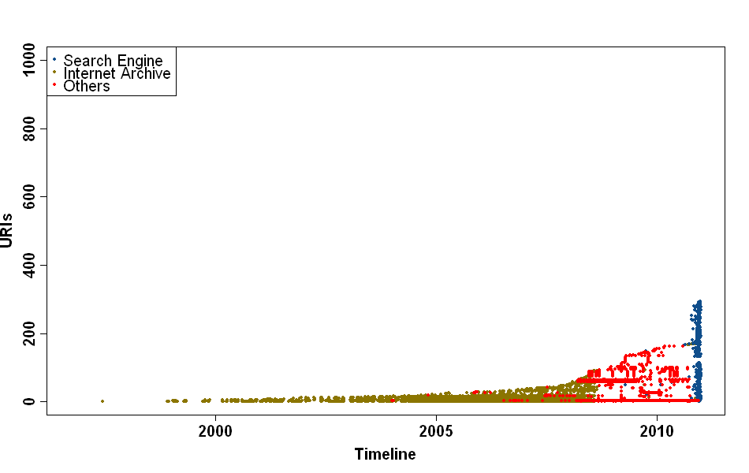
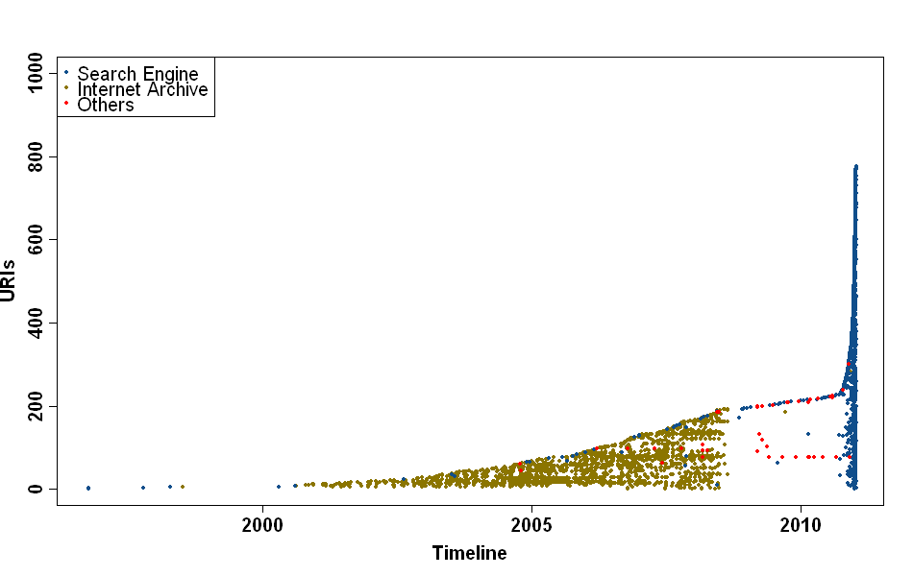

Slide 53
How Much of the Web is Archived? It Depends on Which Web…
 | Including SE cache | Excluding SE Cache
 | 90% | 79%
 | 97% | 68%
 | 35% | 16%
 | 88% | 19%
2013
95%
92%
23%
26%
Changes since 2011: no more free SE APIs;
greatly reduced IA quarantine period; 15+ public web archives

Slide 54
Web Science:
Archiving the Web
(Part 3 - How Can We Navigate Through Time on the Web?)
CS 432/532
Old Dominion University
Permission has been granted to use these slides from Frank McCown, Michael L. Nelson, Alexander Nwala, Michele C. Weigle
This work is licensed under a Creative Commons Attribution-NonCommercial-ShareAlike 3.0 Unported License

Slide 55

Memento: Time Travel for the Web
The Memento Team
Herbert Van de Sompel Michael L. Nelson
Robert Sanderson
Lyudmila Balakireva
Scott Ainsworth
Harihar Shankar
Memento was partially funded by the Library of Congress
Memento 101 slides
RFC 7089: HTTP Framework for Time-Based Access to Resource States -- Memento, December 2013

Slide 56
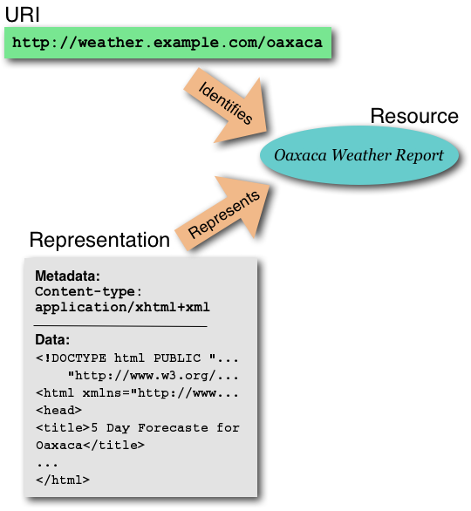
Recall Web Architecture
URIs identify Resources
Representations represent Resources
When URIs are dereferenced, they return representations (not resources)
source: Architecture of the World Wide Web, Volume One

Slide 57
Content Negotiation
Different representations may be returned for the same URI (e.g., English vs. French version, HTML vs. XML)
Represents
Representation
Metadata:
Content-type:
application/xml
-------------------------------
Data:
<?xml version="1.0" encoding="ISO-8859-1"?>
<location>Oaxaca, Mexico</location>
<station_id>KBVX</station_id>
<latitude>16.8922</latitude>
<longitude>-96.4085</longitude>
</xml>
source: Architecture of the World Wide Web, Volume One

Slide 58
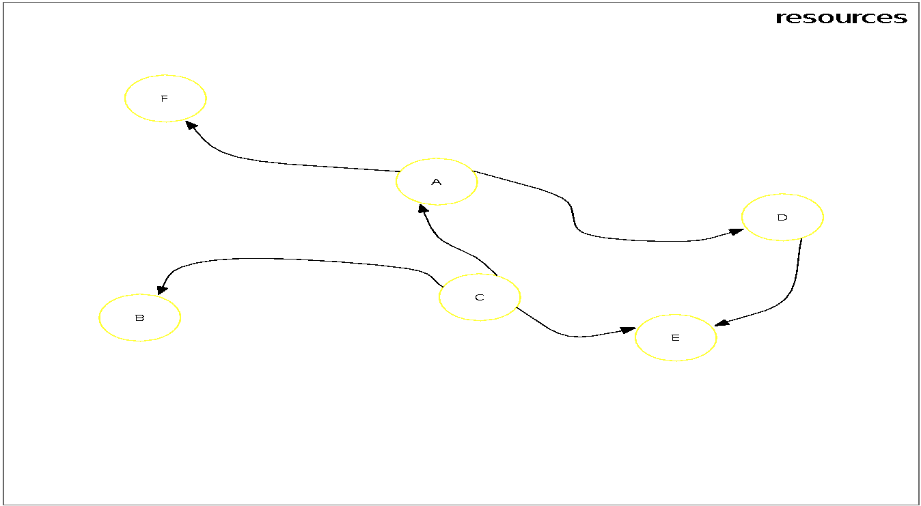
Resources
source: Memento 101 slides

Slide 59
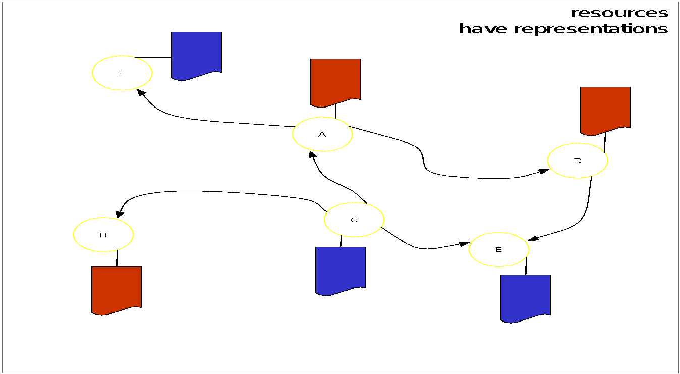
Resources have Representations
source: Memento 101 slides

Slide 60
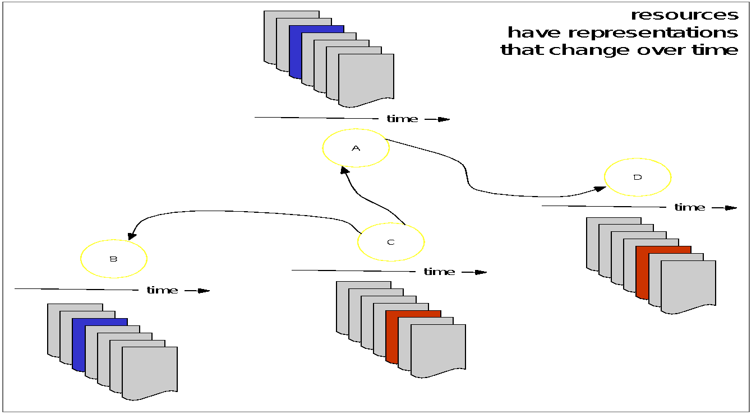
Resources have Representations that Change over Time
source: Memento 101 slides

Slide 61
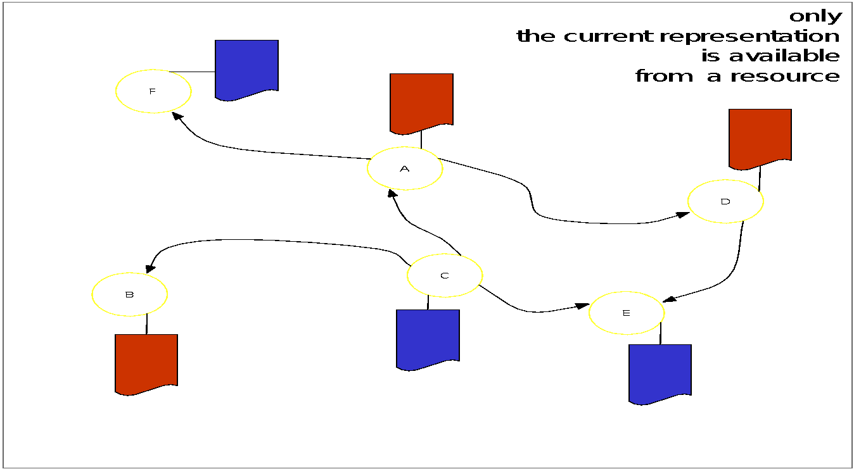
Only the Current Representation is Available from a Resource
source: Memento 101 slides

Slide 62
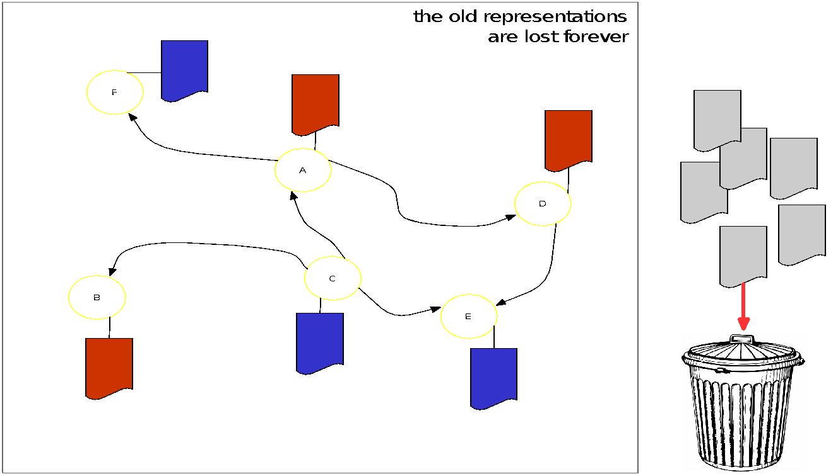
Old Representations are Lost Forever
source: Memento 101 slides

Slide 63
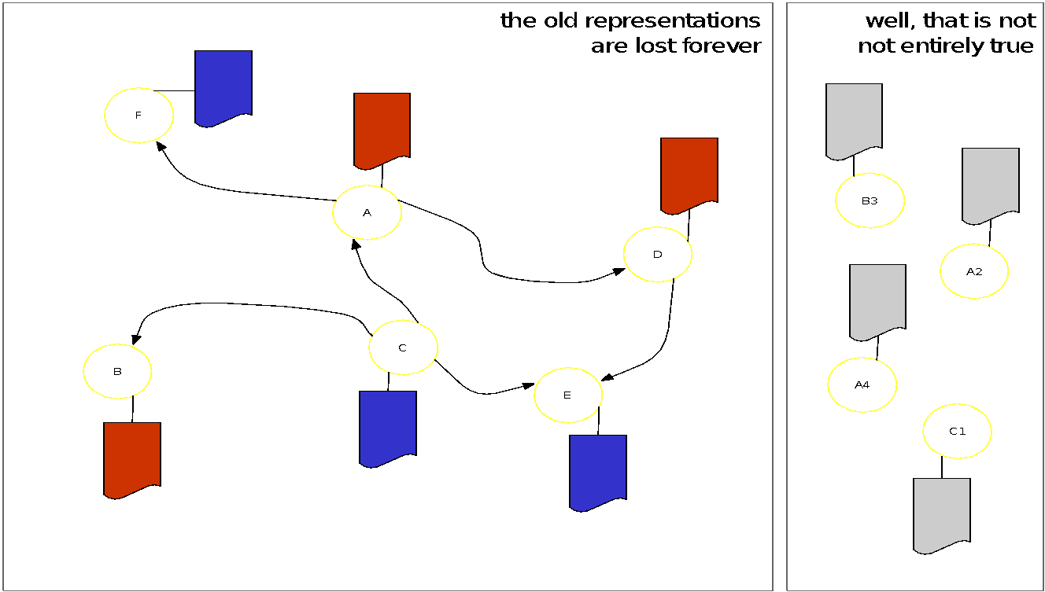
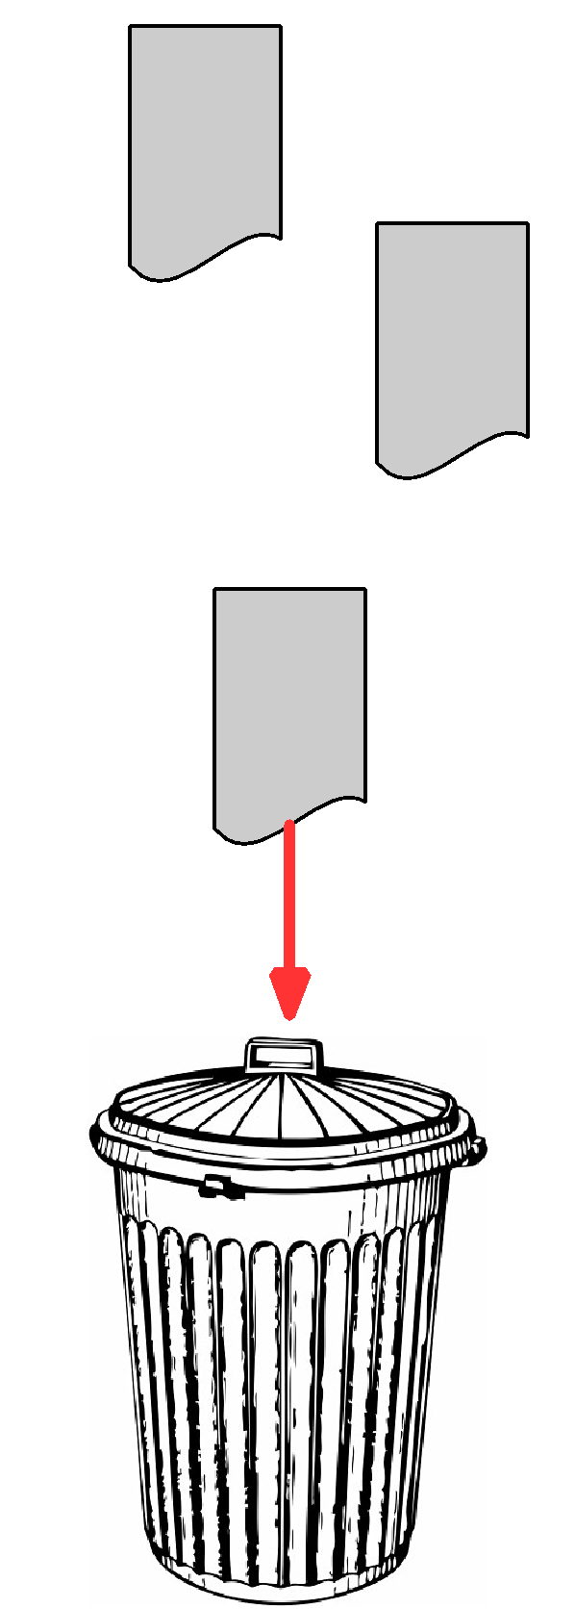
Archived Resources Exist
source: Memento 101 slides

Slide 64
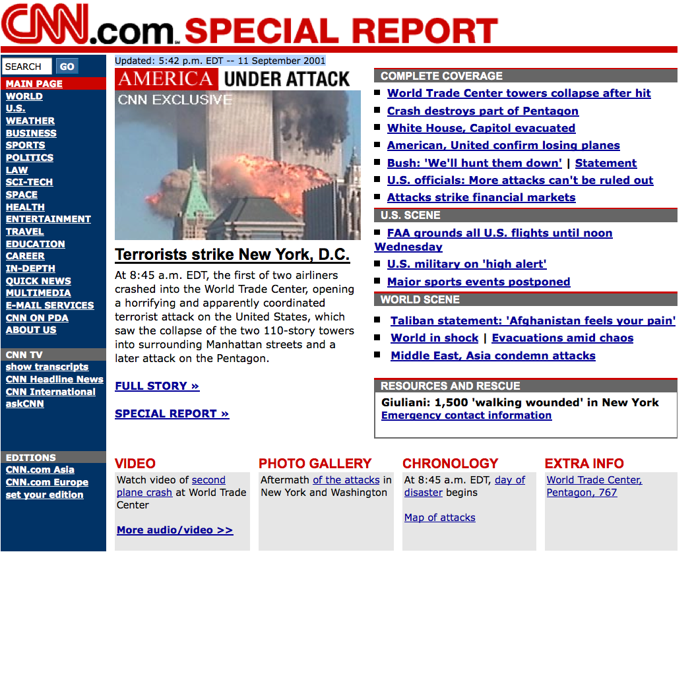
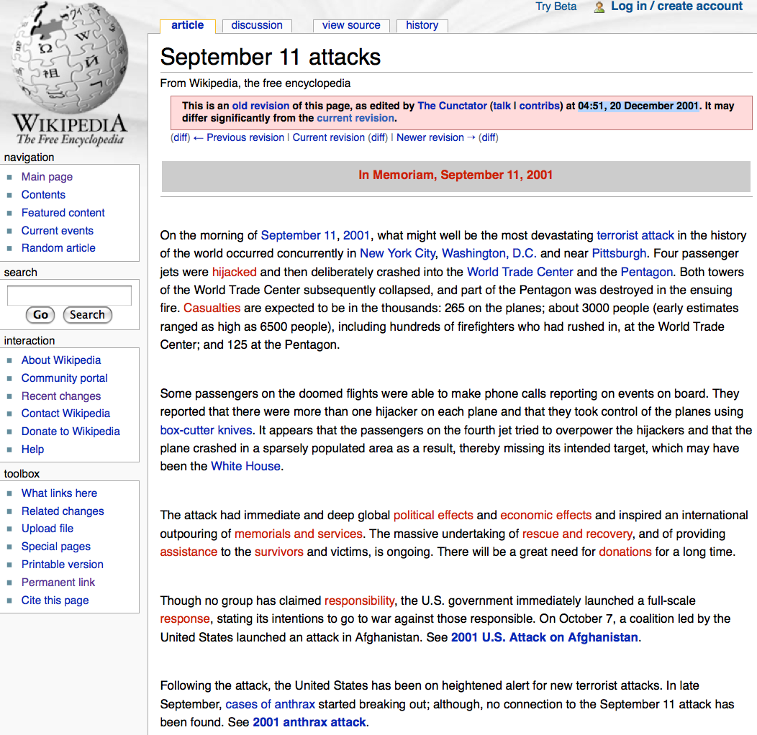
Archived Resources
Sep 11 2001, 20:36:10 UTC
Dec 20 2001, 4:51:00 UTC
http://web.archive.org/web/20010911203610/http://www.cnn.com/
archived resource for http://cnn.com
http://en.wikipedia.org/w/index.php?title=September_11_attacks&oldid=282333
archived resource for http://en.wikipedia.org/wiki/September_11_attacks
source: Memento 101 slides

Slide 65
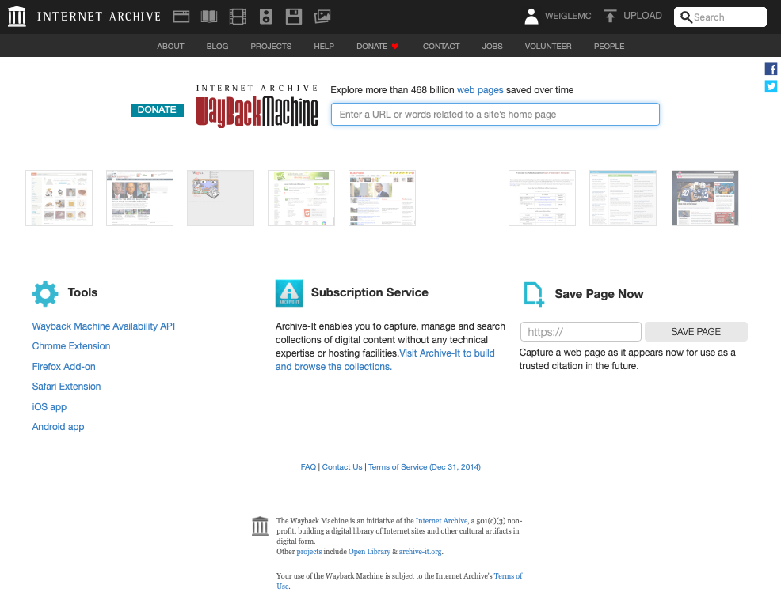
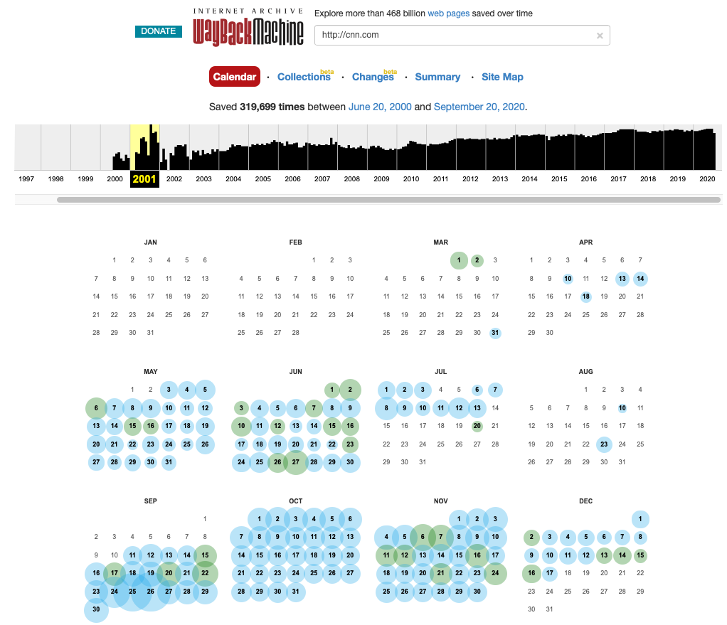
Finding Archived Resources
Go to http://web.archive.org/ and search
http://cnn.com
On http://web.archive.org/web/*/http://cnn.com, select desired datetime
source: Memento 101 slides (Wayback Machine images updated Sep 2020)

Slide 66
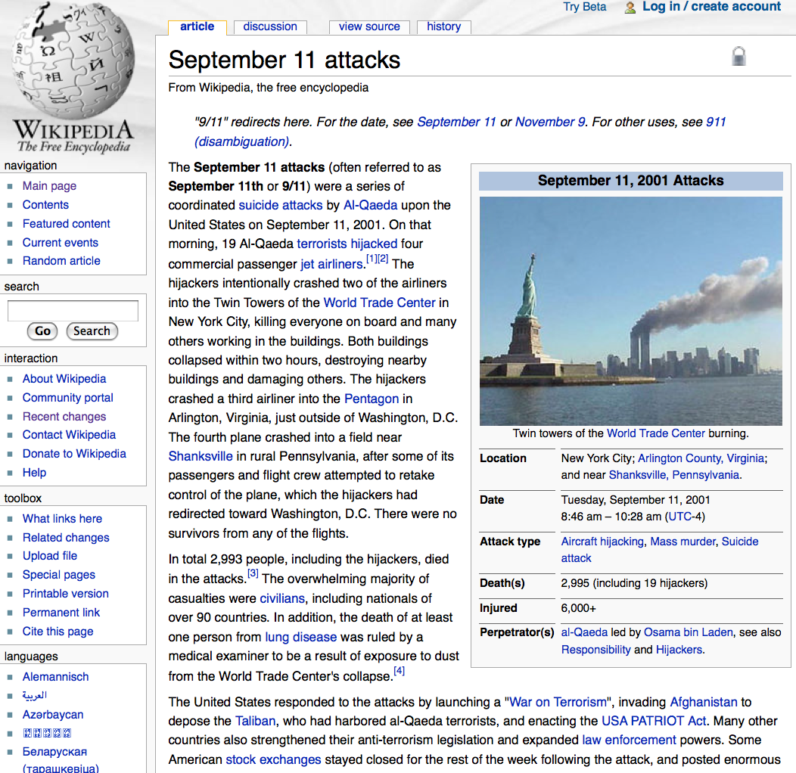

Finding Archived Resources
Go to
http://en.wikipedia.org/wiki/September_11_attacks
and click History
Browse History
source: Memento 101 slides

Slide 67

Navigating Archived Resources
Dec 20 2001, 4:51:00 UTC
current
Pentagon
http://en.wikipedia.org/w/index.php?title=September_11_attacks&oldid=282333
archived resource for http://en.wikipedia.org/wiki/September_11_attacks
http://en.wikipedia.org/wiki/The_Pentagon
source: Memento 101 slides

Slide 68

Navigating Archived Resources
Sep 11 2001, 20:36:10 UTC
Sep 11 2001, 21:38:55 UTC
SPACE
http://web.archive.org/web/20010911203610/http://www.cnn.com/
archived resource for http://cnn.com
http://web.archive.org/web/20010911213855/www.cnn.com/TECH/space/
source: Memento 101 slides

Slide 69

By Default, Current and Past Web are Not Integrated
Current and Past Web based on same technology.
But, going from Current to Past Web is a matter of (manual) discovery.
Memento makes going from Current to Past Web a (HTTP) protocol matter.
Memento integrates the Current and Past Web.
source: Memento 101 slides

Slide 70

The Past Links to the Present…
http://webcitation.org/query?id=1257028234035091
explicit HTML link;
no HTTP links;
opaque URI

Slide 71

The Past Links to the Present…
http://web.archive.org/web/20090516160321/www.digitalpreservation.gov/
no HTML links;
no HTTP links;
implicit from URI

Slide 72

But the Present Does Not Link to the Past
no hints in HTML,
HTTP, or URI
% telnet www.digitalpreservation.gov 80
Trying 140.147.249.7...
Connected to www.digitalpreservation.gov.
Escape character is '^]'.
HEAD / HTTP/1.1
Host: www.digitalpreservation.gov
Connection: close
HTTP/1.1 200 OK
Date: Mon, 19 Jul 2010 21:36:00 GMT
Server: Apache
Accept-Ranges: bytes
Connection: close
Content-Type: text/html
Connection closed by foreign host.

Slide 73
Linking the Past and the Present
Codify existing methods to create linkage from the past to the present
easy: an archived version knows for which URI it is an archived version
Create a linkage from the present to the past
hard: solve with a level of indirection from present to past

Slide 74

Memento Terminology
source: Brunelle, “Scripts in a Frame: A Two-Tiered Approach for Archiving Deferred Representations”, Dissertation Defense, February 5, 2016.

Slide 75

The Web without a Time Dimension

Slide 76
The Web without a Time Dimension

Slide 77
The Web without a Time Dimension
Need to use a different URI to access archived versions of a resource and its current version

Slide 78

The Web with Time Dimension added by Memento
In Memento: use URI of the current version to access archived versions, but qualify it with datetime

Slide 79


The Web with Time Dimension added by Memento
… and arrive at an archived version via level of indirection
TimeGate

Slide 80

Memento Framework
source: Brunelle, “Scripts in a Frame: A Two-Tiered Approach for Archiving Deferred Representations”, Dissertation Defense, February 5, 2016.

Slide 81


Normal HTTP Flow
GET R
200 OK

Slide 82
Normal HTTP Flow
GET R
200 OK

Slide 83


Memento HTTP Flow
HEAD R, Accept-Datetime
200, Link➔G
GET G, Accept-Datetime
302➔M, Vary, Link➔R,B,M
GET M, Accept-Datetime
200, Memento-Datetime, Link➔R,B,M

Slide 84
Memento HTTP Flow
HEAD R, Accept-Datetime
200, Link➔G
GET G, Accept-Datetime
302➔M, Vary, Link➔R,B,M
GET M, Accept-Datetime
200, Memento-Datetime, Link➔R,B,M

Slide 85
Memento HTTP Flow
HEAD R, Accept-Datetime
200, Link➔G
GET G, Accept-Datetime
302➔M, Vary, Link➔R,B,M
GET M, Accept-Datetime
200, Memento-Datetime, Link➔R,B,M

Slide 86
Memento HTTP Flow
HEAD R, Accept-Datetime
200, Link➔G
GET G, Accept-Datetime
302➔M, Vary, Link➔R,B,M
GET M, Accept-Datetime
200, Memento-Datetime, Link➔R,B,M

Slide 87
Memento HTTP Flow
HEAD R, Accept-Datetime
200, Link➔G
GET G, Accept-Datetime
302➔M, Vary, Link➔R,B,M
GET M, Accept-Datetime
200, Memento-Datetime, Link➔R,B,M

Slide 88
Memento HTTP Flow
HEAD R, Accept-Datetime
200, Link➔G
GET G, Accept-Datetime
302➔M, Vary, Link➔R,B,M
GET M, Accept-Datetime
200, Memento-Datetime, Link➔R,B,M

Slide 89
Hints from the live web server
HEAD /demo-special/index.php/Daenerys_Targaryen HTTP/1.1
User-Agent: curl/7.19.7 (x86_64-redhat-linux-gnu) libcurl/7.19.7 NSS/3.14.3.0 zlib/1.2.3 libidn/1.18 libssh2/1.4.2
Host: localhost:8080
Accept: */*
Accept-Datetime: Thu, 01 Jan 2012 00:00:00 GMT
HTTP/1.1 200 OK
Date: Mon, 14 Apr 2014 22:35:17 GMT
Server: Apache/2.2.15 (Red Hat)
X-Powered-By: PHP/5.3.3
X-Content-Type-Options: nosniff
Link: <http://ws-dl-10.cs.odu.edu/demo-special/index.php/Daenerys_Targaryen>; rel="original latest-version",
<http://ws-dl-10.cs.odu.edu/demo-special/index.php/Special:TimeGate/Daenerys_Targaryen>; rel="timegate",
<http://ws-dl-10.cs.odu.edu/demo-special/index.php/Special:TimeMap/Daenerys_Targaryen>; rel="timemap";
type="application/link-format"
Content-language: en
Vary: Accept-Encoding,Accept-Datetime,Cookie
Cache-Control: s-maxage=18000, must-revalidate, max-age=0
Last-Modified: Tue, 08 Apr 2014 00:20:01 GMT
Connection: close
Content-Type: text/html; charset=UTF-8
WS-DL blog, "TimeGate Design Options For MediaWiki"

Slide 90
Aggregator TimeMap - Link Format
$ curl -i http://memgator.cs.odu.edu/timemap/link/http://www.cs.odu.edu/~mln/
HTTP/1.1 200 OK
Access-Control-Allow-Origin: *
Access-Control-Expose-Headers: Link, Location, X-Memento-Count, X-Generator
Content-Type: application/link-format
Date: Sun, 02 Feb 2020 20:10:43 GMT
X-Generator: MemGator:1.0-rc7
X-Memento-Count: 633
Transfer-Encoding: chunked
<http://www.cs.odu.edu/~mln/>; rel="original",
<https://memgator.cs.odu.edu/timemap/link/http://www.cs.odu.edu/~mln/>; rel="self"; type="application/link-format",
<http://web.archive.org/web/20020526053005/http://www.cs.odu.edu:80/~mln/>; rel="first memento"; datetime="Sun, 26 May 2002 05:30:05 GMT",
<http://web.archive.org/web/20020528083321/http://www.cs.odu.edu:80/~mln/>; rel="memento"; datetime="Tue, 28 May 2002 08:33:21 GMT",
<http://web.archive.org/web/20020720051448/http://www.cs.odu.edu:80/~mln>; rel="memento"; datetime="Sat, 20 Jul 2002 05:14:48 GMT",
<http://web.archive.org/web/20020724230216/http://www.cs.odu.edu:80/~mln/>; rel="memento"; datetime="Wed, 24 Jul 2002 23:02:16 GMT",
<http://web.archive.org/web/20020811035033/http://www.cs.odu.edu:80/~mln>; rel="memento"; datetime="Sun, 11 Aug 2002 03:50:33 GMT",
<http://web.archive.org/web/20021005054529/http://www.cs.odu.edu:80/~mln/>; rel="memento"; datetime="Sat, 05 Oct 2002 05:45:29 GMT",
...
ODU MemGator

Slide 91
Aggregator TimeMap - JSON Format
$ curl -i http://memgator.cs.odu.edu/timemap/json/http://www.cs.odu.edu/~mln/
HTTP/1.1 200 OK
Access-Control-Allow-Origin: *
Access-Control-Expose-Headers: Link, Location, X-Memento-Count, X-Generator
Content-Type: application/json
Date: Sun, 02 Feb 2020 20:09:25 GMT
X-Generator: MemGator:1.0-rc7
X-Memento-Count: 633
Transfer-Encoding: chunked
{
"original_uri": "http://www.cs.odu.edu/~mln/",
"self": "https://memgator.cs.odu.edu/timemap/json/http://www.cs.odu.edu/~mln/",
"mementos": {
"list": [
{
"datetime": "2002-05-26T05:30:05Z",
"uri": "http://web.archive.org/web/20020526053005/http://www.cs.odu.edu:80/~mln/"
},
{
"datetime": "2002-05-28T08:33:21Z",
"uri": "http://web.archive.org/web/20020528083321/http://www.cs.odu.edu:80/~mln/"
},
{
"datetime": "2002-07-20T05:14:48Z",
"uri": "http://web.archive.org/web/20020720051448/http://www.cs.odu.edu:80/~mln"
},
...

Slide 92

More Than Just Internet Archive
source: Brunelle, “Scripts in a Frame: A Two-Tiered Approach for Archiving Deferred Representations”, Dissertation Defense, February 5, 2016.

Slide 93
More Than Just Internet Archive
$ curl -i http://memgator.cs.odu.edu/timemap/link/http://www.cs.odu.edu/~mln/ | grep -v web.archive.org
Server: nginx/1.11.3
Date: Thu, 02 Feb 2017 05:46:35 GMT
Content-Type: application/link-format
Transfer-Encoding: chunked
Connection: keep-alive
Access-Control-Allow-Origin: *
Access-Control-Expose-Headers: Link, Location, X-Memento-Count, X-Generator
X-Generator: MemGator:1.0-rc7
X-Memento-Count: 338
<http://www.cs.odu.edu/~mln/>; rel="original",
<http://memgator.cs.odu.edu/timemap/link/http://www.cs.odu.edu/~mln/>; rel="self"; type="application/link-format",
<http://archive.is/20130618185742/http://www.cs.odu.edu/~mln/>; rel="memento"; datetime="Tue, 18 Jun 2013 18:57:42 GMT",
<http://archive.is/20130621194047/http://www.cs.odu.edu/~mln/>; rel="memento"; datetime="Fri, 21 Jun 2013 19:40:47 GMT",
<http://archive.is/20130723172543/http://www.cs.odu.edu/~mln/>; rel="memento"; datetime="Tue, 23 Jul 2013 17:25:43 GMT",
<http://archive.is/20130723173951/http://www.cs.odu.edu/~mln/>; rel="memento"; datetime="Tue, 23 Jul 2013 17:39:51 GMT",
<http://archive.is/20130728010336/http://www.cs.odu.edu/~mln/>; rel="memento"; datetime="Sun, 28 Jul 2013 01:03:36 GMT",
<http://archive.is/20131217200455/http://www.cs.odu.edu/~mln/>; rel="memento"; datetime="Tue, 17 Dec 2013 20:04:55 GMT",
<http://archive.is/20141015185128/http://www.cs.odu.edu/~mln/>; rel="memento"; datetime="Wed, 15 Oct 2014 18:51:28 GMT",
<http://archive.is/20141020194524/http://www.cs.odu.edu/~mln/>; rel="memento"; datetime="Mon, 20 Oct 2014 19:45:24 GMT",
<http://archive.is/20141112185338/http://www.cs.odu.edu/~mln/>; rel="memento"; datetime="Wed, 12 Nov 2014 18:53:38 GMT",
<http://archive.is/20141120172147/http://www.cs.odu.edu/~mln/>; rel="memento"; datetime="Thu, 20 Nov 2014 17:21:47 GMT",
<http://archive.is/20141207184200/http://www.cs.odu.edu/~mln/>; rel="memento"; datetime="Sun, 07 Dec 2014 18:42:00 GMT",
<http://archive.is/20141207184737/http://www.cs.odu.edu/~mln/>; rel="memento"; datetime="Sun, 07 Dec 2014 18:47:37 GMT",
<http://archive.is/20150205233109/http://www.cs.odu.edu/~mln/>; rel="memento"; datetime="Thu, 05 Feb 2015 23:31:09 GMT",
<http://archive.is/20150514160142/http://www.cs.odu.edu/~mln/>; rel="memento"; datetime="Thu, 14 May 2015 16:01:42 GMT",
<http://archive.is/20150519034827/http://www.cs.odu.edu/~mln/>; rel="memento"; datetime="Tue, 19 May 2015 03:48:27 GMT",
<http://archive.is/20150519041853/http://www.cs.odu.edu/~mln/>; rel="memento"; datetime="Tue, 19 May 2015 04:18:53 GMT",
<http://archive.is/20150707000027/http://www.cs.odu.edu/~mln/>; rel="memento"; datetime="Tue, 07 Jul 2015 00:00:27 GMT",
<http://wayback.archive-it.org/all/20150921151807/http://www.cs.odu.edu/%7Emln/>; rel="memento";
datetime="Mon, 21 Sep 2015 15:18:07 GMT",
<http://wayback.archive-it.org/all/20150921164637/http://www.cs.odu.edu/~mln/>; rel="memento";
datetime="Mon, 21 Sep 2015 16:46:37 GMT",
...

Slide 94
Aggregator TimeGate
$ curl -I -H "Accept-datetime: Mon, 22 Jul 2013 00:00:00 GMT" \
http://memgator.cs.odu.edu/timegate/http://www.cs.odu.edu/~mln/
HTTP/1.1 302 Found
Server: nginx/1.11.3
Date: Thu, 02 Feb 2017 05:49:13 GMT
Content-Type: text/plain; charset=utf-8
Connection: keep-alive
Access-Control-Allow-Origin: *
Access-Control-Expose-Headers: Link, Location, X-Memento-Count, X-Generator
Link: <http://www.cs.odu.edu/~mln/>; rel="original",
<http://web.archive.org/web/20020526053005/http://www.cs.odu.edu/~mln/>;
rel="first memento"; datetime="Sun, 26 May 2002 05:30:05 GMT",
<http://web.archive.org/web/20130702115017/http://www.cs.odu.edu/~mln/>;
rel="prev memento"; datetime="Tue, 02 Jul 2013 11:50:17 GMT",
<http://archive.is/20130723172543/http://www.cs.odu.edu/~mln/>; rel="memento";
datetime="Tue, 23 Jul 2013 17:25:43 GMT",
<http://web.archive.org/web/20130730042519/http://www.cs.odu.edu/~mln/>;
rel="next memento"; datetime="Tue, 30 Jul 2013 04:25:19 GMT",
<http://archive.is/20170202053722/http://www.cs.odu.edu/~mln/>; rel="last memento";
datetime="Thu, 02 Feb 2017 05:37:22 GMT",
<http://memgator.cs.odu.edu/timemap/link/http://www.cs.odu.edu/~mln/>; rel="timemap";
type="application/link-format",
<http://memgator.cs.odu.edu/timemap/json/http://www.cs.odu.edu/~mln/>;
rel="timemap"; type="application/json",
<http://memgator.cs.odu.edu/timemap/cdxj/http://www.cs.odu.edu/~mln/>;
rel="timemap"; type="application/cdxj+ors",
<http://memgator.cs.odu.edu/timegate/http://www.cs.odu.edu/~mln/>; rel="timegate"
Location: http://archive.is/20130723172543/http://www.cs.odu.edu/~mln/
Vary: accept-datetime
X-Generator: MemGator:1.0-rc7

Slide 95
Reminder that 302s can have entities…
$ curl -H "Accept-datetime: Mon, 22 Jul 2013 00:00:00 GMT" \
http://memgator.cs.odu.edu/timegate/http://www.cs.odu.edu/~mln/
<a href="http://archive.is/20130723172543/http://www.cs.odu.edu/~mln/">Found</a>.
$ curl -i -H "Accept-datetime: Mon, 22 Jul 2013 00:00:00 GMT" \
http://memgator.cs.odu.edu/timegate/http://www.cs.odu.edu/~mln/
HTTP/1.1 302 Found
Server: nginx/1.11.3
Date: Thu, 02 Feb 2017 05:54:20 GMT
Content-Type: text/html; charset=utf-8
Content-Length: 83
Connection: keep-alive
...
Location: http://archive.md/20130723172543/http://www.cs.odu.edu/~mln/
Vary: accept-datetime
X-Generator: MemGator:1.0-rc7
<a href="http://archive.md/20130723172543/http://www.cs.odu.edu/~mln/">Found</a>.

Slide 96
Web Science:
Archiving the Web
(Part 4 - User Interfaces for Navigating Through Time on the Web)
CS 432/532
Old Dominion University
Permission has been granted to use these slides from Frank McCown, Michael L. Nelson, Alexander Nwala, Michele C. Weigle
This work is licensed under a Creative Commons Attribution-NonCommercial-ShareAlike 3.0 Unported License

Slide 97






Tools
Browsing Past Web
Memento for Chrome
Mink (Chrome)
Wayback Machine (Firefox)
On-Demand Archiving
IA Save Page Now
archive.is/archive.today
Conifer

Slide 98
Time Travel with Memento for Chrome
Memento Time Travel (Google Chrome store)
WS-DL blog, "Right-Click to the Past -- Memento for Chrome"

Slide 99

Memento for Chrome
Uses TimeGate for negotiation
Can request a link at a specific datetime

Slide 100

Time Travel: Read Like It's 2004
webpage: Rethinking Scholarly Communication: Building the System that Scholars Deserve

Slide 101

Time Travel: Scroll To The Bottom, First Reference
http://www.communitytechnology.org/nsf_ci_report/

Slide 102

Time Travel: Link in 2020 Redirects To Main Site
URI: http://www.communitytechnology.org/nsf_ci_report/ -> http://www.communitytechnology.org/

Slide 103

Time Travel: Set For September 15, 2004

Slide 104

Time Travel: Right Click On The Link

Slide 105

Time Travel: The Report @ 2004-10-12
URI-M: https://web.archive.org/web/20041012155445/http://www.communitytechnology.org/nsf_ci_report/
List of URI-Ms: http://timetravel.mementoweb.org/list/20040915093256/http://www.communitytechnology.org/nsf_ci_report/

Slide 106
Time Travel: Fifth Reference
http://www.arl.org/newsltr/226/ir.html

Slide 107

Time Travel: Current Page Is 404

Slide 108

Time Travel: Right Click On The Link

Slide 109

Time Travel: Page As Of 2004-10-12
URI-M: https://web.archive.org/web/20041012054551/http://www.arl.org:80/newsltr/226/ir.html
List of URI-Ms: http://timetravel.mementoweb.org/list/20040915054551/http://www.arl.org/newsltr/226/ir.html

Slide 110
Time Travel with Mink
Developed while Mat was a PhD student at ODU
Mink at Google Chrome Store

Slide 111
Mink
Uses TimeMap (list of mementos)
Must first have a valid memento to visit other mementos directly
<http://www.cs.odu.edu/~mln/>; rel="original",
<https://memgator.cs.odu.edu/timemap/link/http://www.cs.odu.edu/~mln/>; rel="self"; type="application/link-format",
<http://web.archive.org/web/20020526053005/http://www.cs.odu.edu:80/~mln/>; rel="first memento"; datetime="Sun, 26 May 2002 05:30:05 GMT",
<http://web.archive.org/web/20020528083321/http://www.cs.odu.edu:80/~mln/>; rel="memento"; datetime="Tue, 28 May 2002 08:33:21 GMT",
<http://web.archive.org/web/20020720051448/http://www.cs.odu.edu:80/~mln>; rel="memento"; datetime="Sat, 20 Jul 2002 05:14:48 GMT",
<http://web.archive.org/web/20020724230216/http://www.cs.odu.edu:80/~mln/>; rel="memento"; datetime="Wed, 24 Jul 2002 23:02:16 GMT",
<http://web.archive.org/web/20020811035033/http://www.cs.odu.edu:80/~mln>; rel="memento"; datetime="Sun, 11 Aug 2002 03:50:33 GMT",
<http://web.archive.org/web/20021005054529/http://www.cs.odu.edu:80/~mln/>; rel="memento"; datetime="Sat, 05 Oct 2002 05:45:29 GMT",

Slide 112
Mink: Read Like It's 2004
webpage: Rethinking Scholarly Communication: Building the System that Scholars Deserve

Slide 113

Mink: Choose memento to view

Slide 114


Mink: Now, links are to mementos

Slide 115

Mink: Click on Fifth Reference

Slide 116


Wayback Machine
Wayback Machine Firefox Extension

Slide 117

Wayback Machine: Click on Sixth Reference
http://www.fedora.info/documents/ecdl2002final.pdf
webpage: Rethinking Scholarly Communication: Building the System that Scholars Deserve

Slide 118

Wayback Machine: Returns 404
URI: https://fedora.info/documents/ecdl2002final.pdf

Slide 119

Wayback Machine: See Archived Version
archived URI: https://web.archive.org/web/20080821233412/http://www.fedora.info/documents/ecdl2002final.pdf

Slide 120

Wayback Machine: Use on Live Page
webpage: Rethinking Scholarly Communication: Building the System that Scholars Deserve

Slide 121

Wayback Machine: Choose First Version
archived URI: https://web.archive.org/web/20040909135231/http://www.dlib.org/dlib/september04/vandesompel/09vandesompel.html

Slide 122
Wayback Machine: Links are to mementos
archived URI: https://web.archive.org/web/20040909135231/http://www.arl.org/newsltr/226/ir.html

Slide 123

Wayback Machine: Click Fifth Reference
archived URI: https://web.archive.org/web/20040909135231/http://www.arl.org/newsltr/226/ir.html

Slide 124
Tools
Browsing Past Web
Memento for Chrome
Mink (Chrome)
Wayback Machine (Firefox)
On-Demand Archiving
IA Save Page Now
archive.is/archive.today
Conifer

Slide 125

IA Save Page Now (SPN)
"If You See Something, Save Something"
"The Wayback Machine’s Save Page Now is New and Improved"

Slide 126

Save Page Now (direct link)
Save Page Now

Slide 127

SPN: Save ODU Homepage

Slide 128

SPN: ODU Homepage Saved

Slide 129

SPN: Replay ODU Homepage
archived URI: https://web.archive.org/web/20200914171203/https://www.odu.edu/

Slide 130

archive.is
On-demand web archiving
Does not render or save JavaScript
Also saves screenshot image
Also known as archive.today
http://archive.is/

Slide 131

archive.is: Save ODU Homepage
http://archive.is/

Slide 132

archive.is: Saving ODU Homepage
http://archive.is/

Slide 133

archive.is: Replay ODU Homepage
Archived webpage URI: https://archive.is/wIbE9

Slide 134

Conifer
On-demand web archiving
High-fidelity captures (renders and executes JavaScript)
Previously known as Webrecorder.io
Conifer | Homepage

Slide 135

Conifer: Save ODU Homepage
Conifer | Homepage

Slide 136

Conifer: Saving ODU Homepage
Conifer | Homepage

Slide 137

Conifer: Replay ODU Homepage
source URI: https://conifer.rhizome.org/mweigle/testing/20200914172346/https://www.odu.edu/

Slide 138
Objectives
Explain the importance of web archiving.
Describe how to find and access archived webpages using the Internet Archive’s Wayback Machine.
Explain how the Memento Framework allows for content negotiation in the time dimension.
Differentiate between a URI-R, URI-M, and URI-T in Memento terminology.
Use the Memgator Memento Aggregator service to download a TimeMap and explain the contents of what is returned.

